Slide 1




Quantum Fluorescent Gold and Superparamagnetic Iron Oxide Nanoparticles for Biomedical Sensing
Regina Maria Chiechio, Antonino Scandurra, Stefano Boscarino, Cristiano Lo Pò, Riccardo Reitano, Paolo Musumeci, Maria Grazia Grimaldi, Maria Chiara Spadaro, Francesco Salutari, Salvatore Baglio, Salvatore Graziani, Annalinda Contino, Giuseppe Maccarrone, Thierry Guizouarn, Olivier Hernandez, Valerie Marchi, Ludovica Maugeri, Salvatore Petralia, Francesco Ruffino.
PE4 NQSTI
Spoke 7
Notes:
“Good morning everyone, my name is Regina Maria Chiechio, I am a researcher at the University of Catania and part of Spoke 7 of the NQSTI project. In this talk, I will present our recent work on quantum fluorescent gold and superparamagnetic iron oxide nanoparticles for biomedical sensing.”

Slide 2
SPOKE 7 Complete Quantum Systems
Quantum Nanostructures for environmental and biomedical sensing
Spoke 7 is focused on the application-oriented development of complete quantum systems based on novel ideas developed in collaboration with spokes 1 and 2, as well as integrated devices and modules that have been simulated, designed and tested in spokes 3, 4, 5 and 6
Activities
A7.1 Imaging Systems
A7.2 Point Sensing Systems
A7.3 Communication & IoT Systems
A7.4 Simulation Systems
A7.2.1: Development of spectroscopy-based sensing system for biomedical and environmental inspection.
A7.2.2: Development of chemical sensing systems for biomedical applications
1

Slide 3
Luminescent Gold Nanoclusters (Au NCs)
Au NCs luminescence mechanism
Au NCs based sensor
Outline
Fe₃O₄ NPs for magnetic field sensing
2

Slide 4
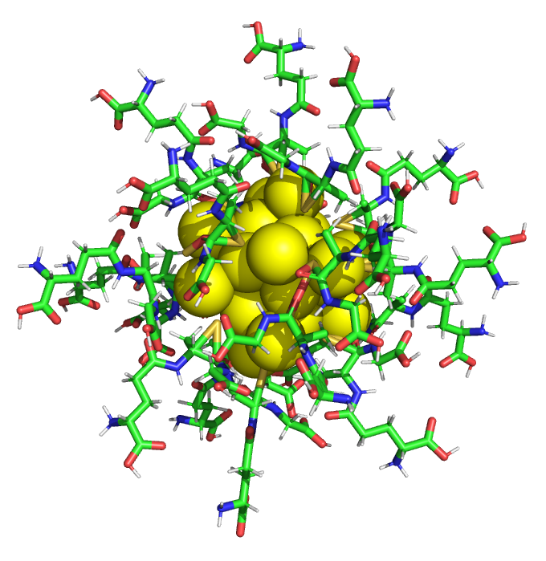
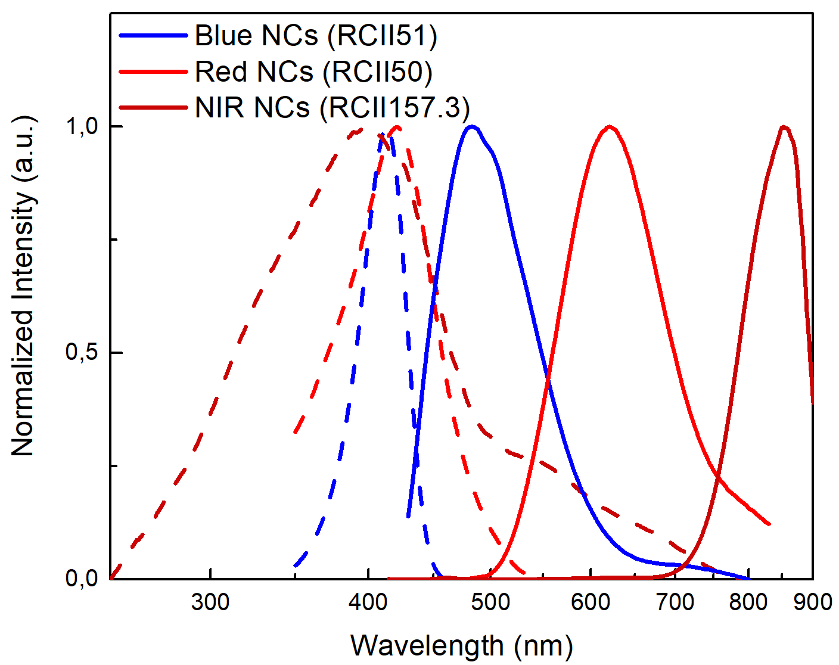
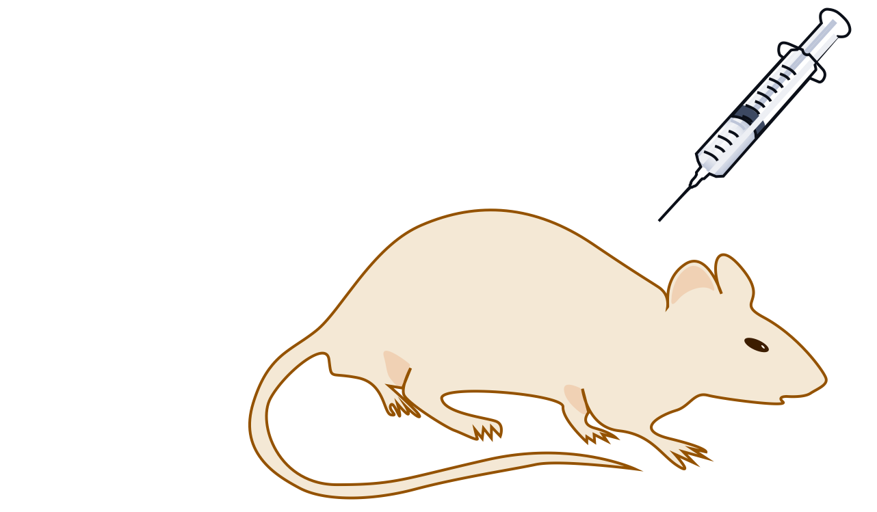
Gold Nanoclusters (Au NCs)
Applications:
High
Biocompatibility
Bioimaging
Drug delivery
Luminescent
Theragnostic
Radiosensitizers
Photostable
(Mussa F. et Al., Prog. Mater. Sci – 2024)
Biosensing
Au NCs
C3E6D Blue NCs
GSH Red NCs
GSH IR NCs
d~2nm
Blood concentration of Au NCs
(Zhang et Al., Scientific Reports – 2015)
3

Slide 5
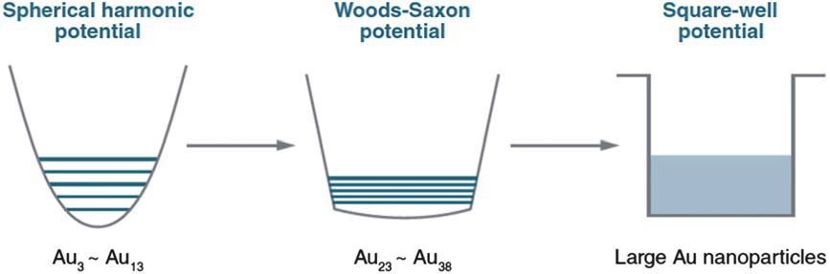
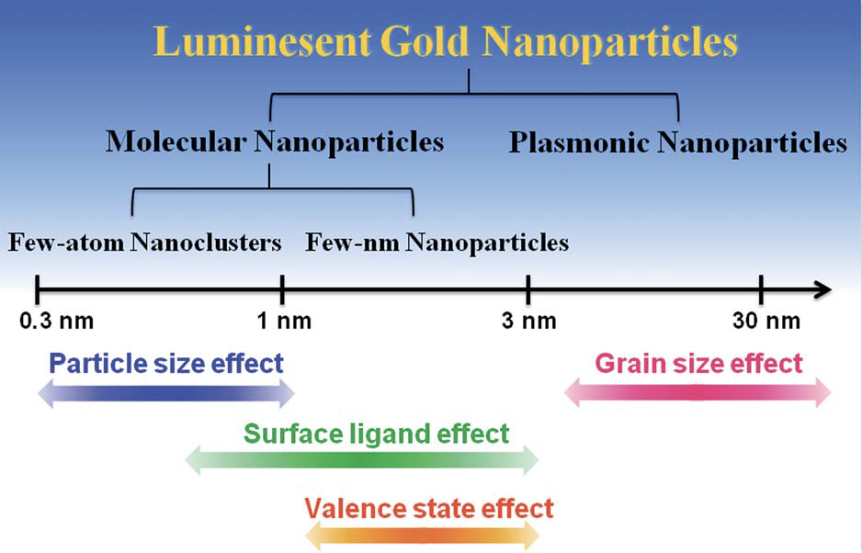
Au NCs: Quantum luminescence
(Core)
(Shell)
LUMOs
(Metal)
Blue NCs
Red NCs
IR NCs
(LT ≃ 0.1 µs)
(LT ≃ 1ns)
(LT ≃ 1 µs)
HOMOs
(Ligand)
Diagram of energy levels of NCs.
(Kevin G. Stamplecoskie et al.- 2013)
4

Slide 6
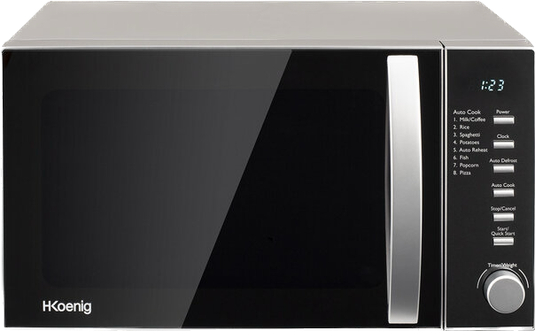
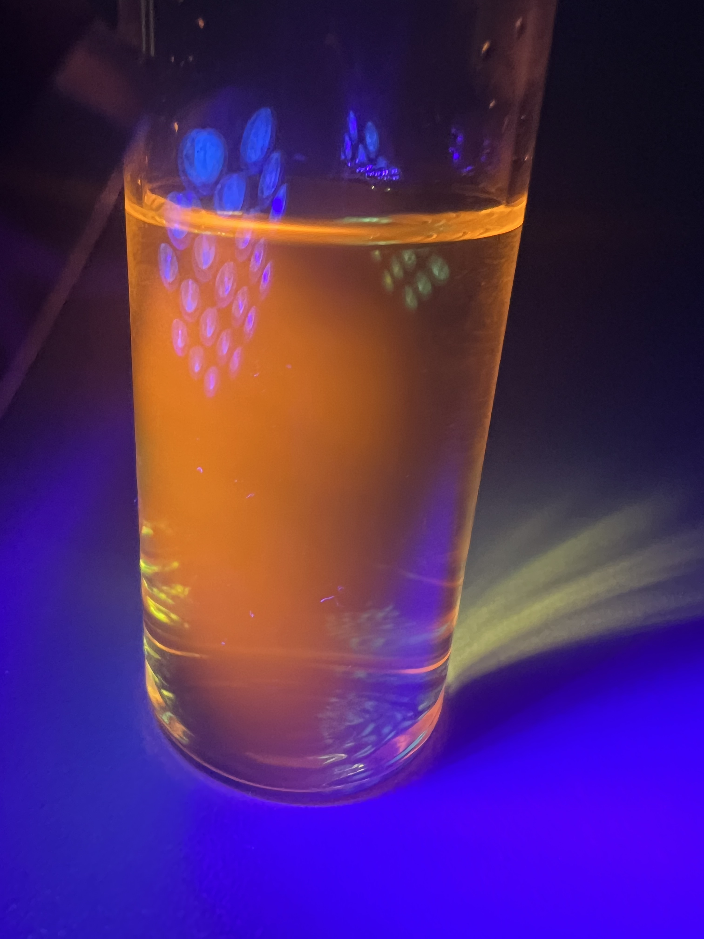
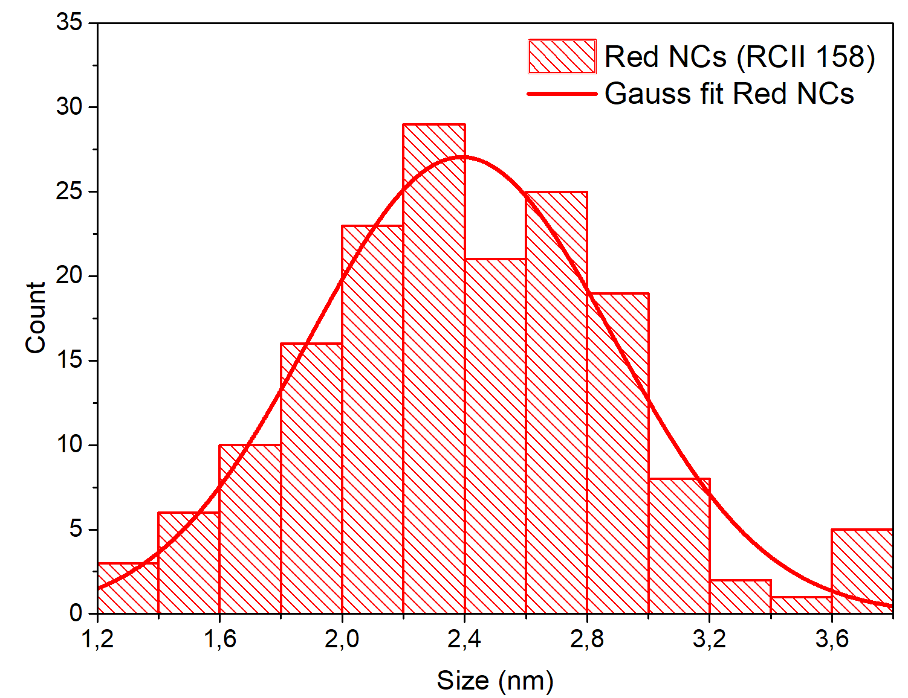
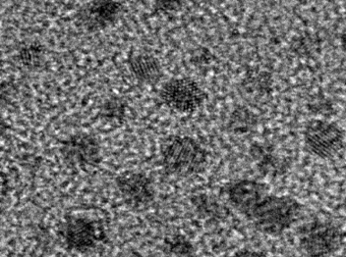
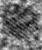
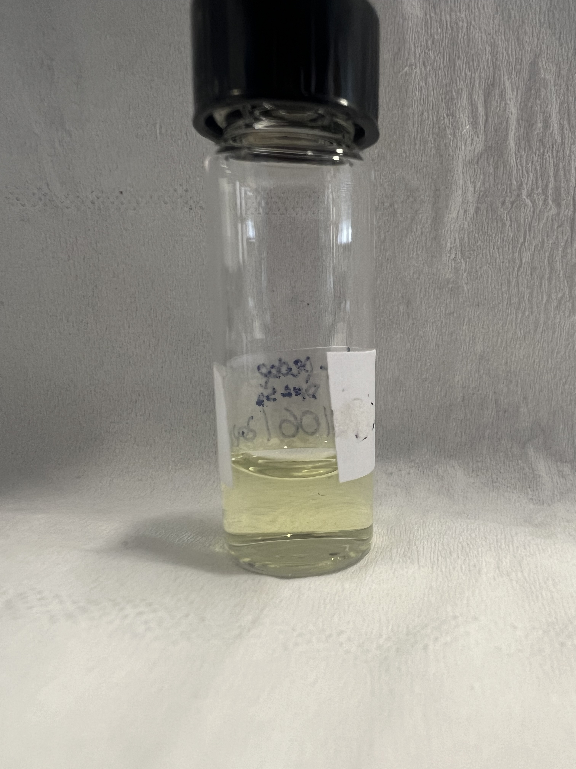
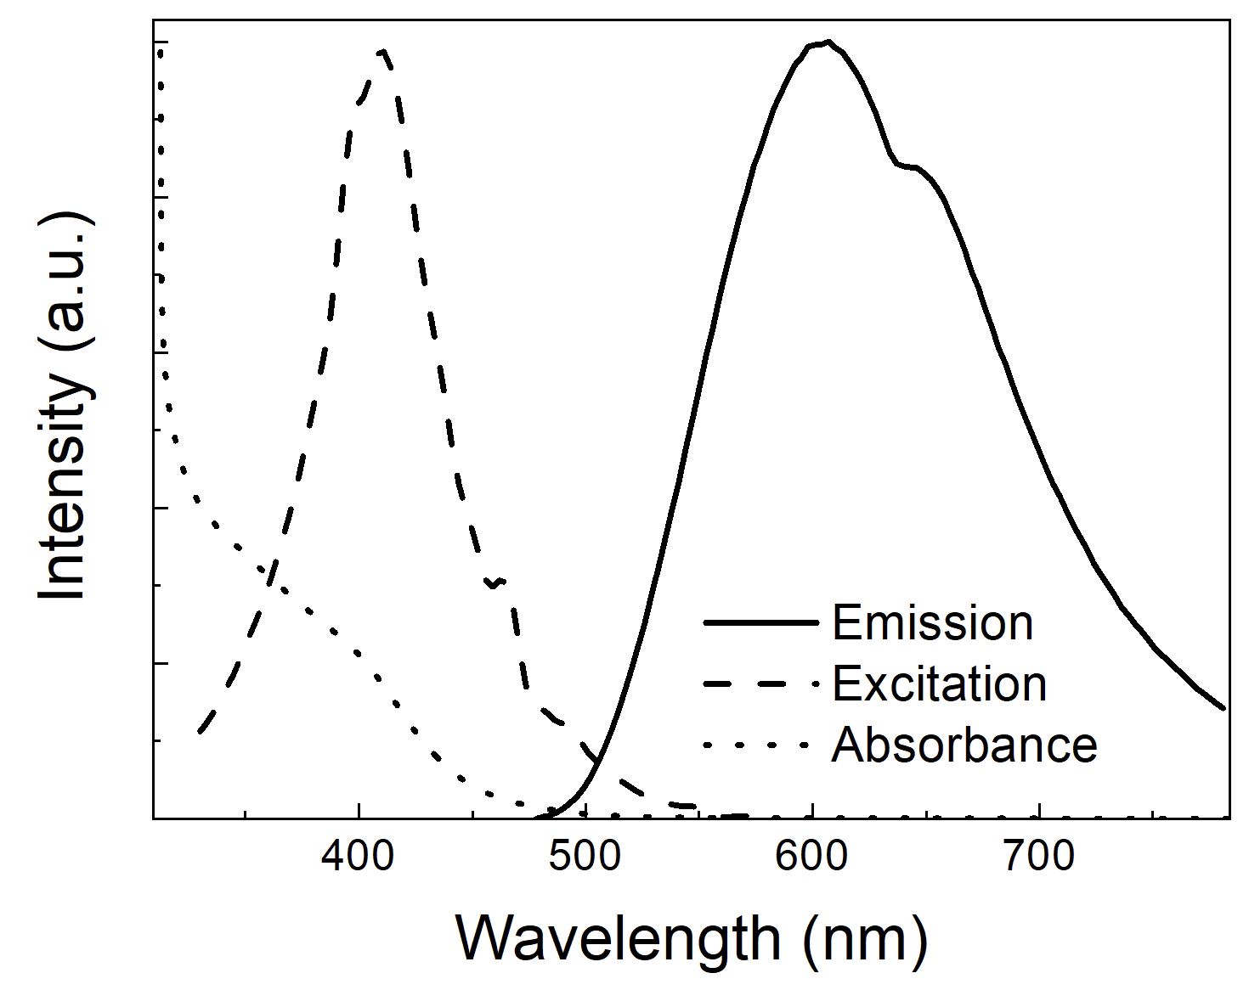
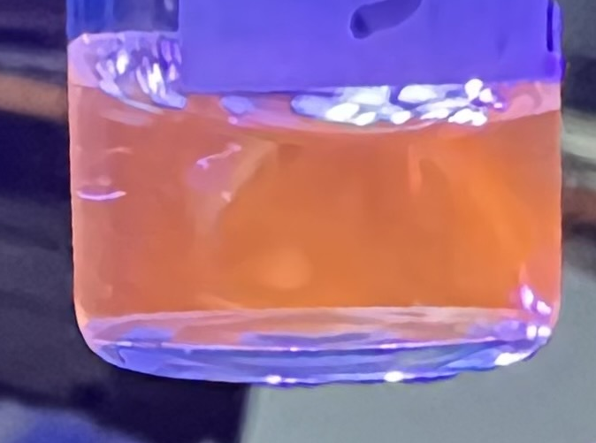
Au NCs: Synthesis
λ_{ex}=420 nm
λ_{em}= 620 nm
GSH
GSH
HAuCl₄
GSH
Size ≃ 2,4 ± 0,5 nm
GSH NCs
1 nm
Crystalline
5nm
Regina M. Chiechio et Al., The Journal of Physical Chemistry Letters - 2022
HR-TEM
5

Slide 7
GSH NCs Liquid Sensor
ssDNA-target
ssDNA-probe
dsDNA
S
S
6

Slide 8
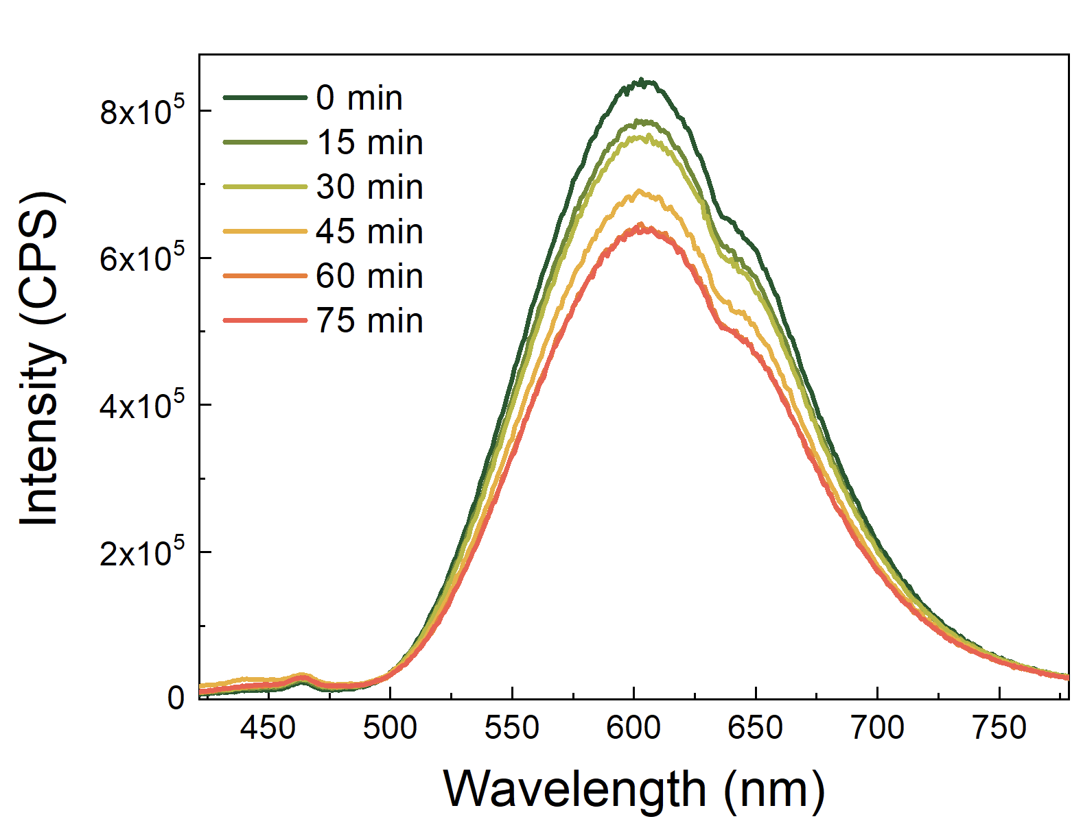
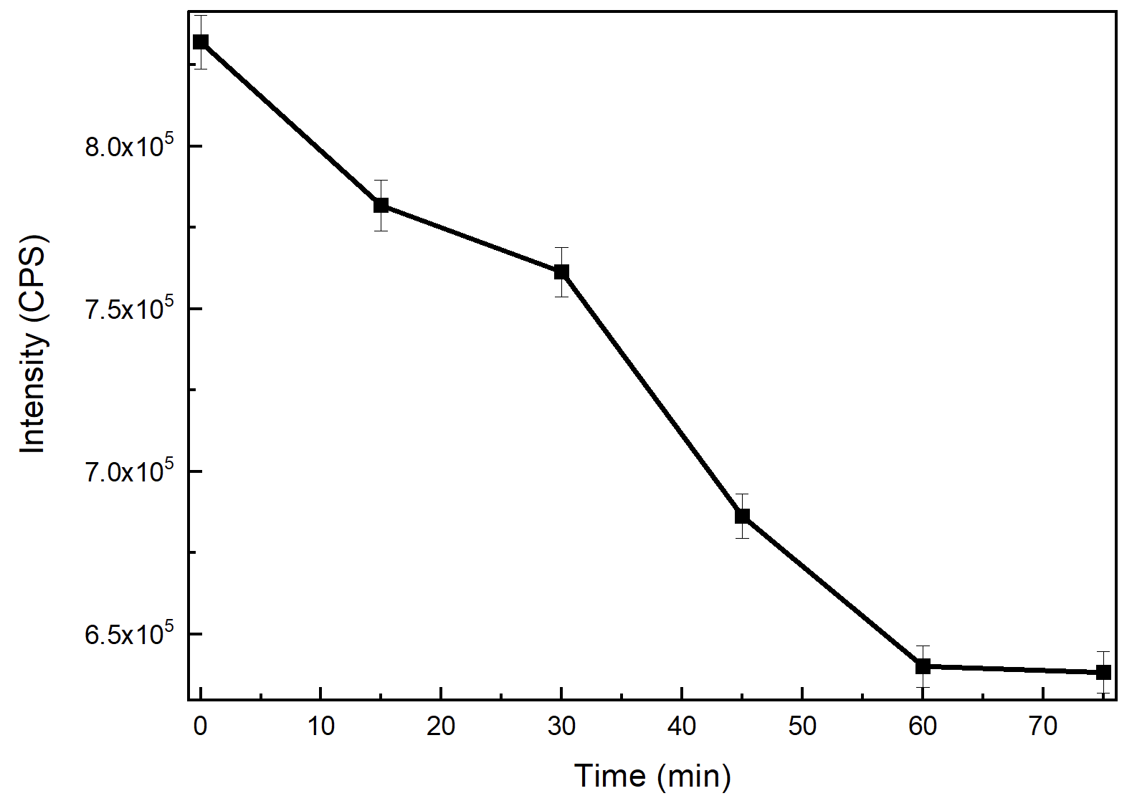
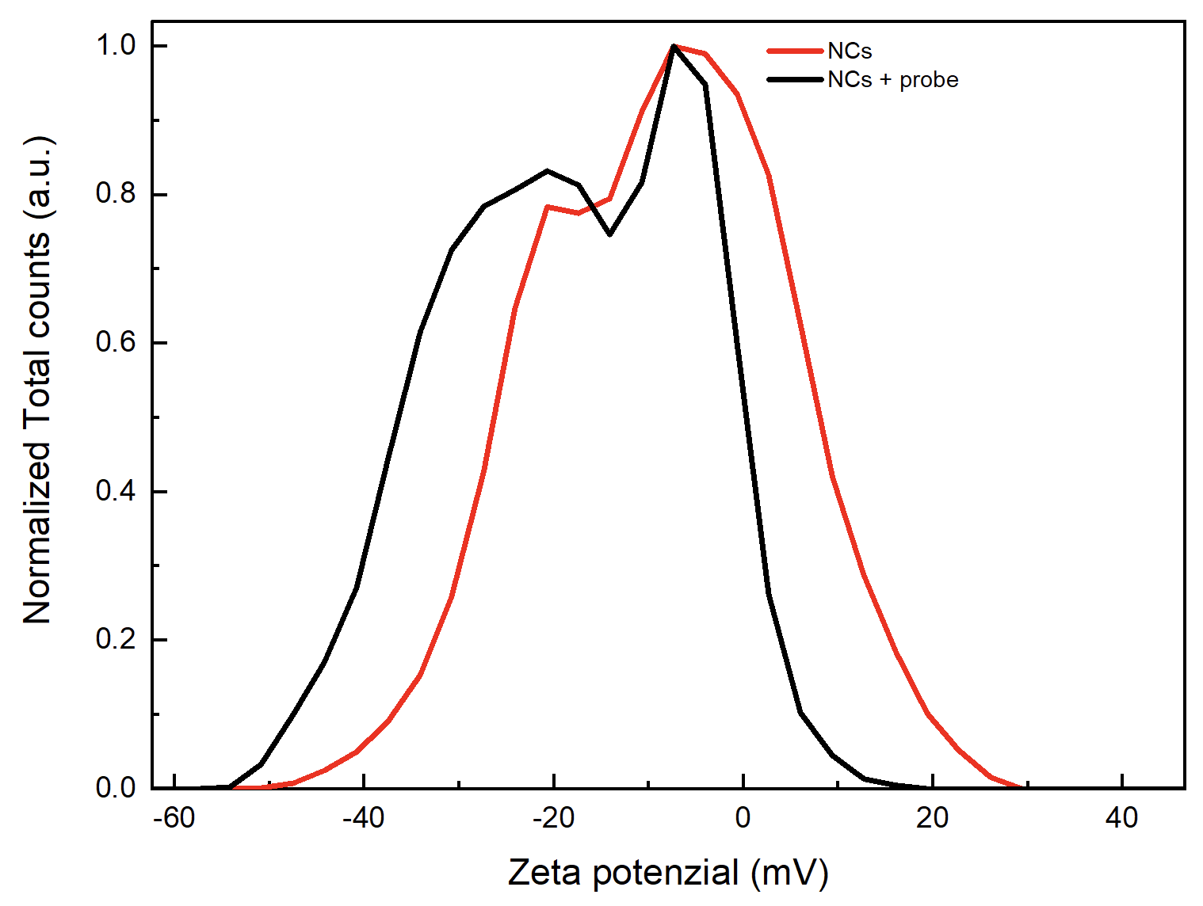
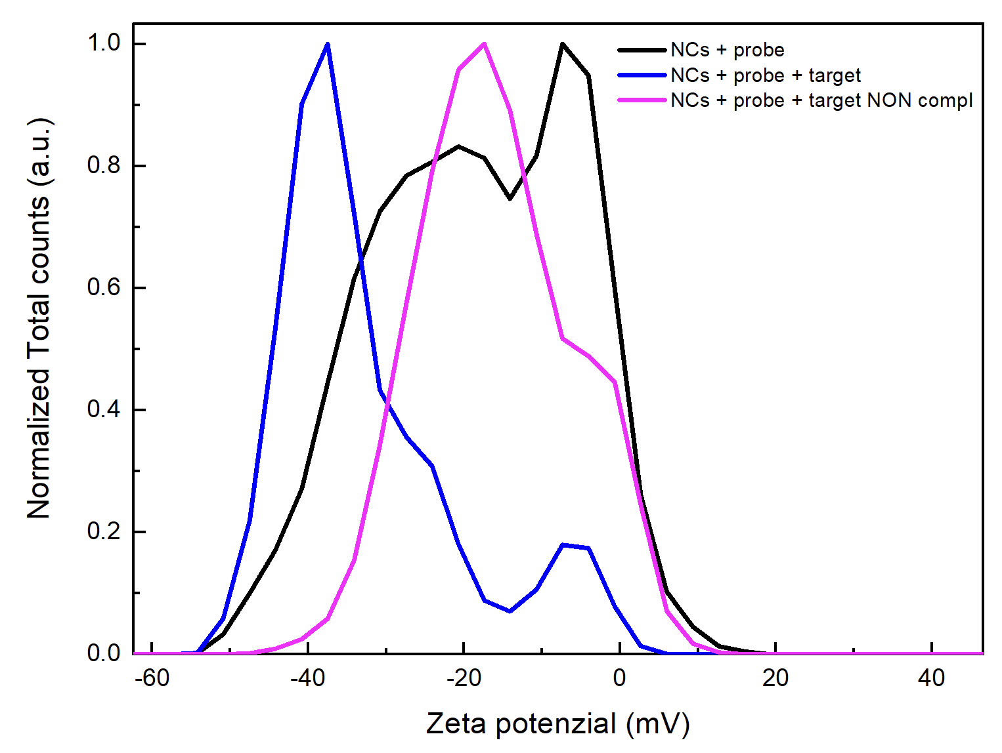
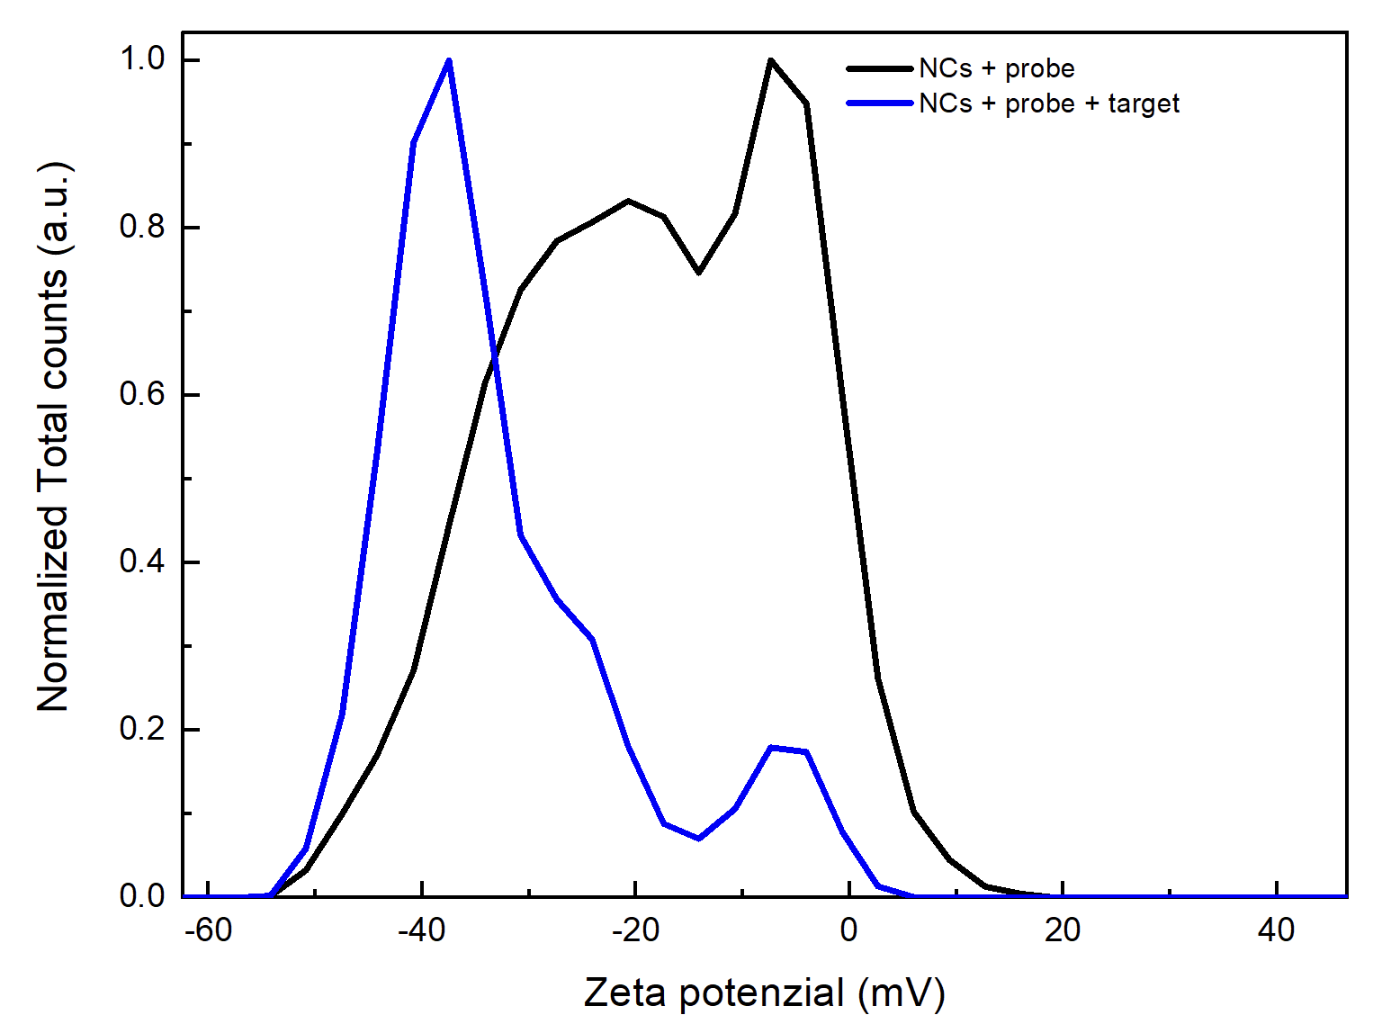
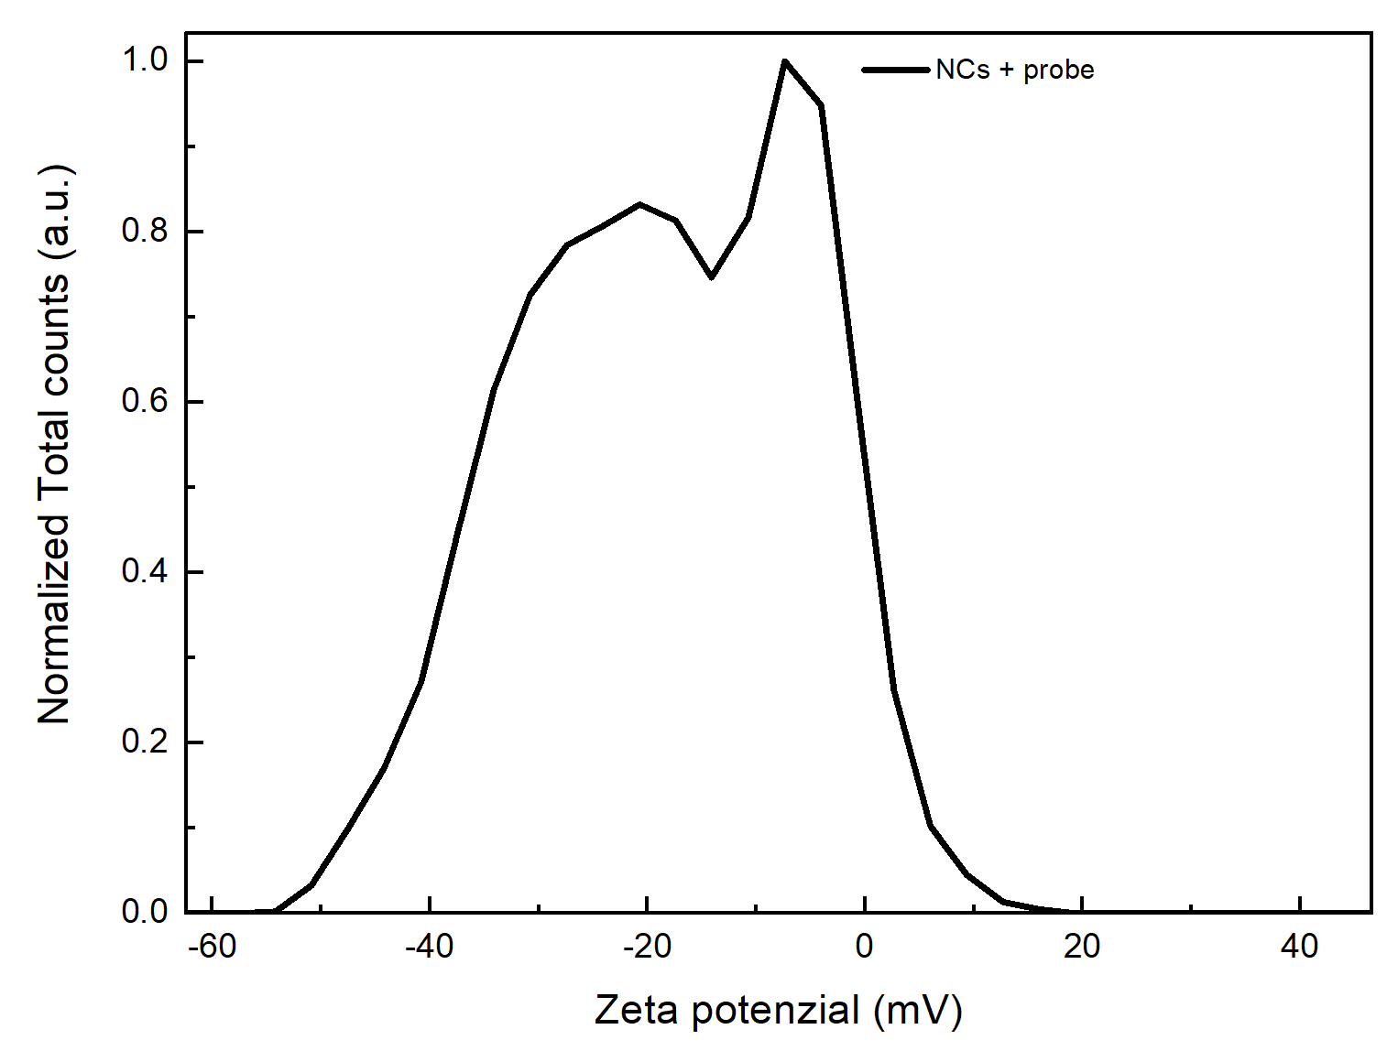
PL
Kinetic study
-7
-20
-40
ssDNA-probe
Zetametry
S
R. Chiechio et Al., Applied Surface Science Advances - 2025
ssDNA-target
7

Slide 9
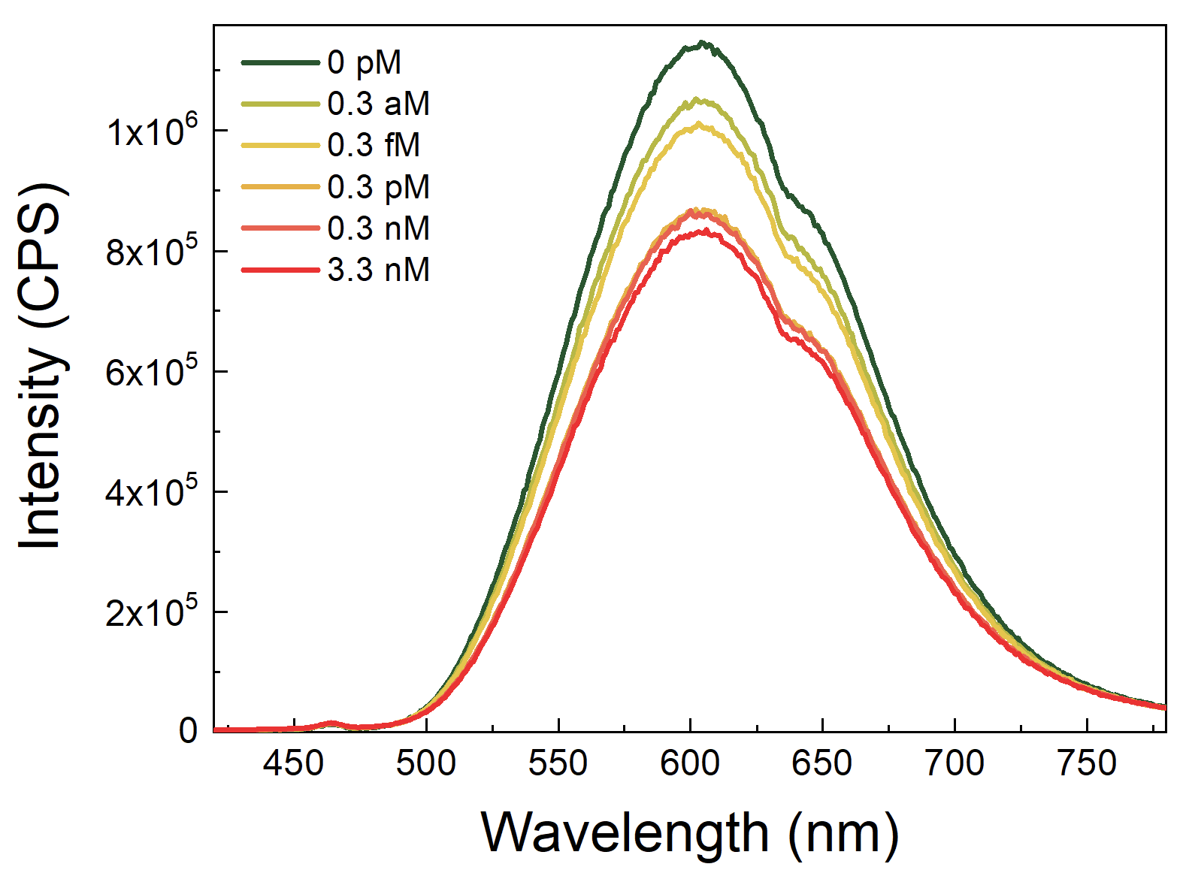
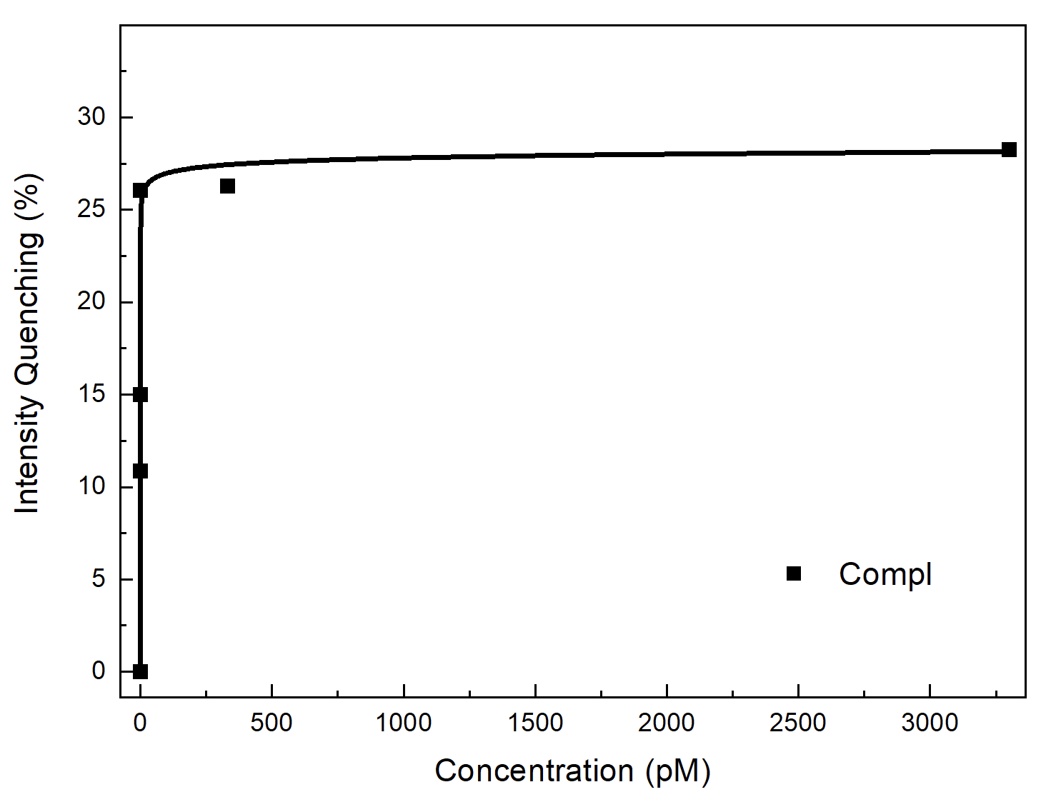
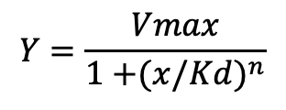
PL
R. Chiechio et Al., Applied Surface Science Advances - 2025
Hill Model:
Target at different concentrations
$$Y=\frac{Vmax}{1{+(x/Kd)}^{n}}$$
(Li, W et Al., Nanoscale Adv. – 2020)
LOD: 25 aM
8

Slide 10
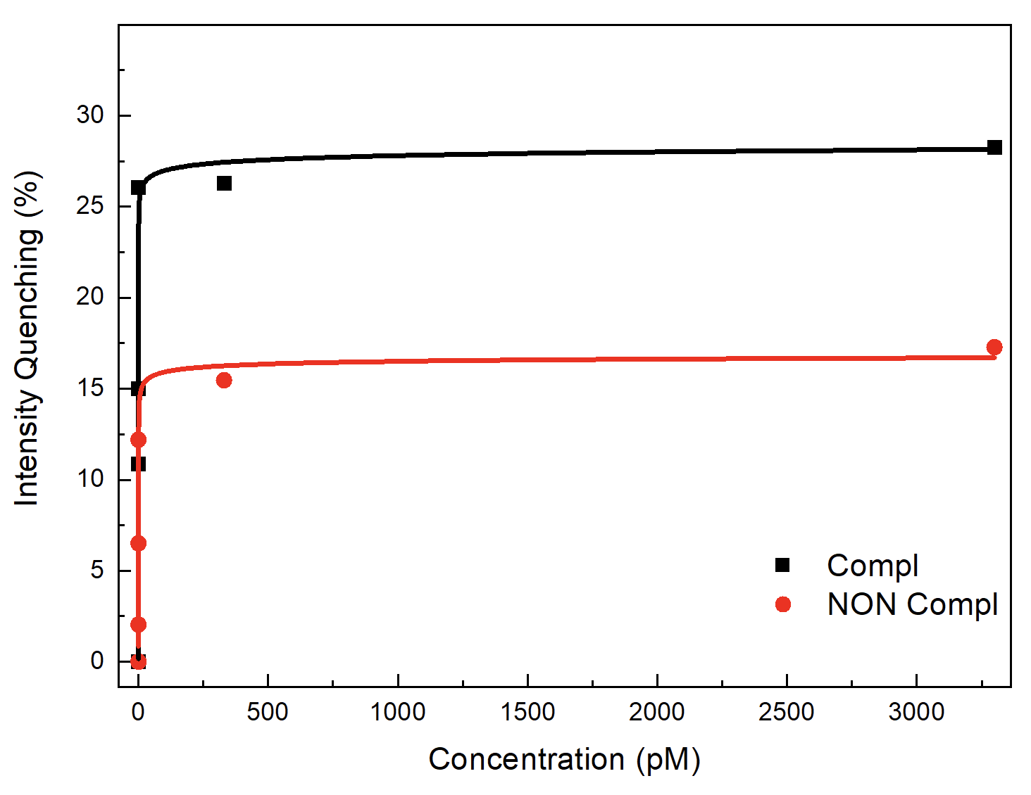
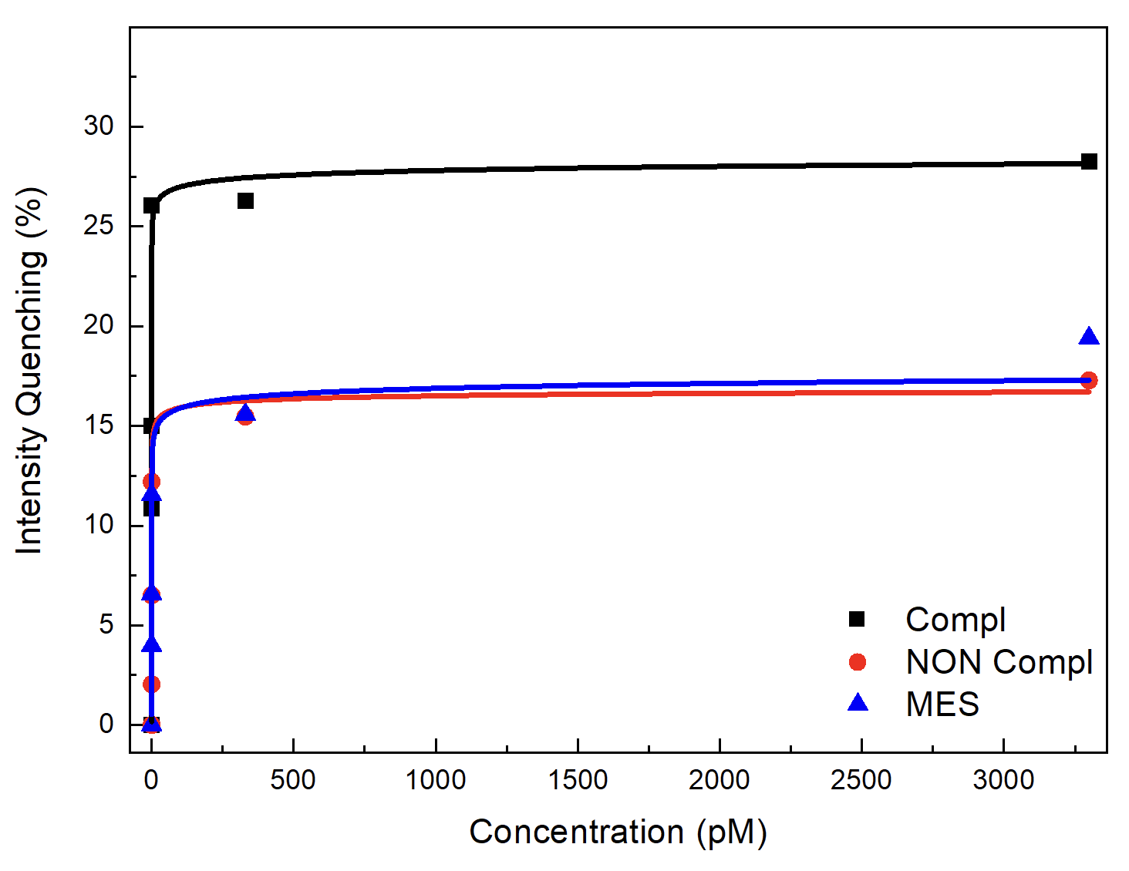
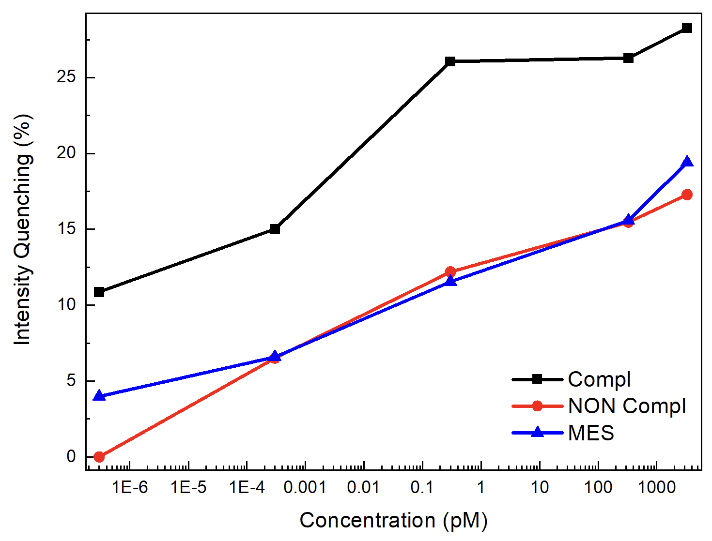
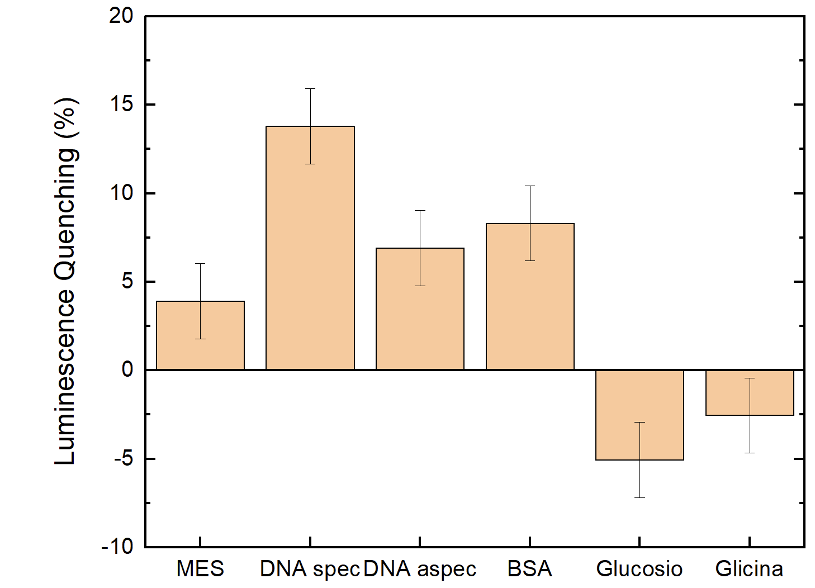
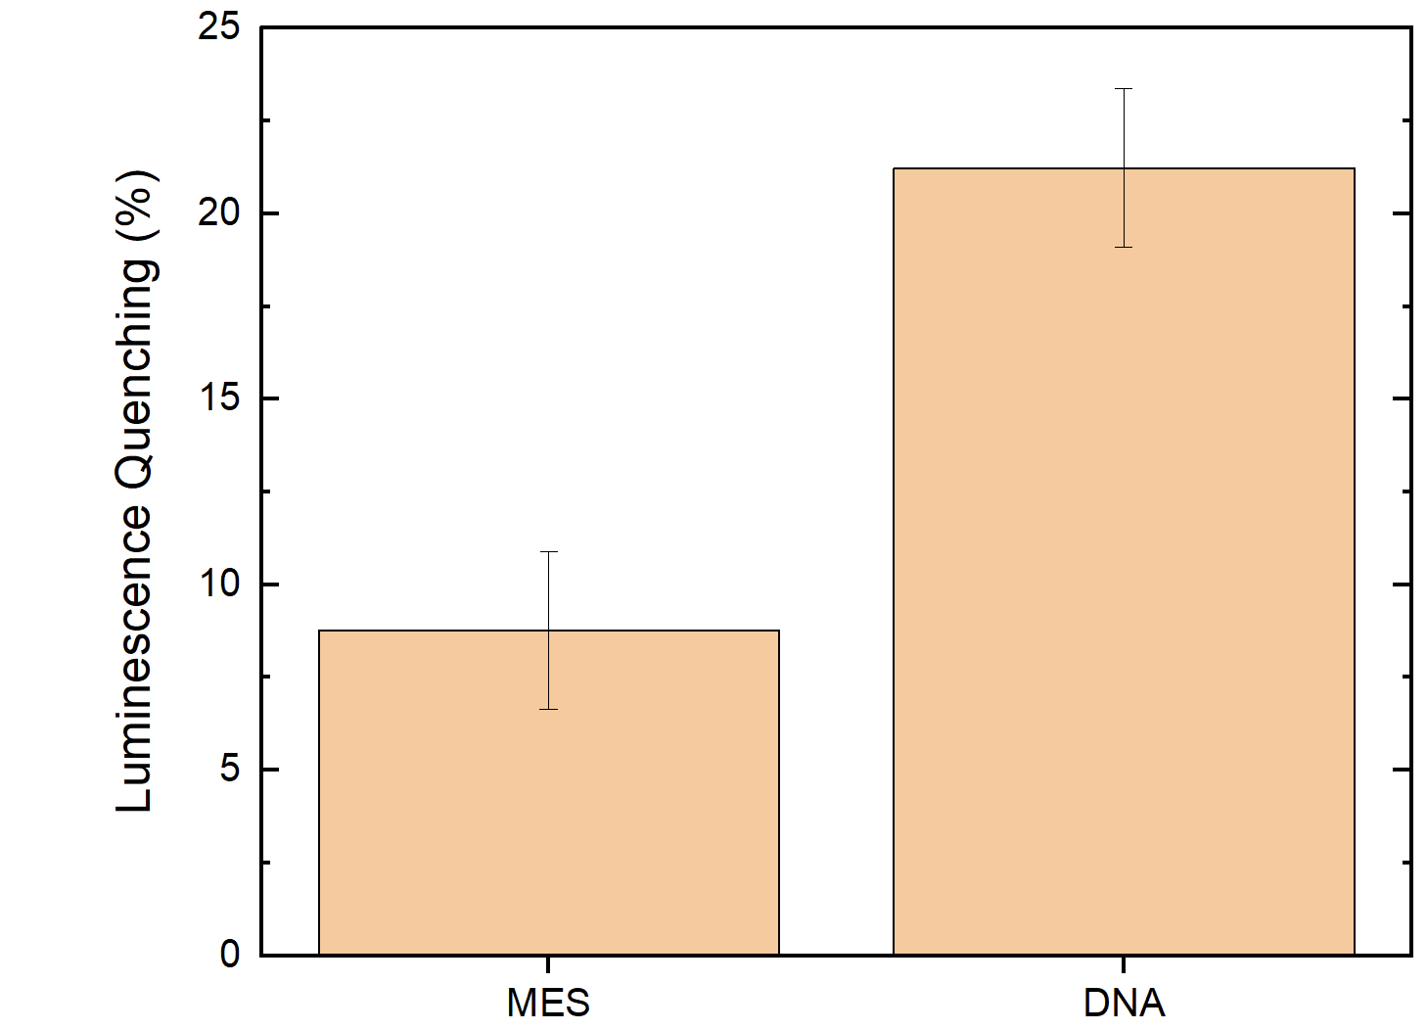
LOG
Compl | NON Compl
Kd = 0.04 ± 0.07 fM | Kd = 10 ± 15 fM
n = 0.15 | n = 0.26
Vmax: 30 % | Vmax: 17 %
Specificity Tests
Blood Test
R. Chiechio et Al., Applied Surface Science Advances - 2025
9

Slide 11
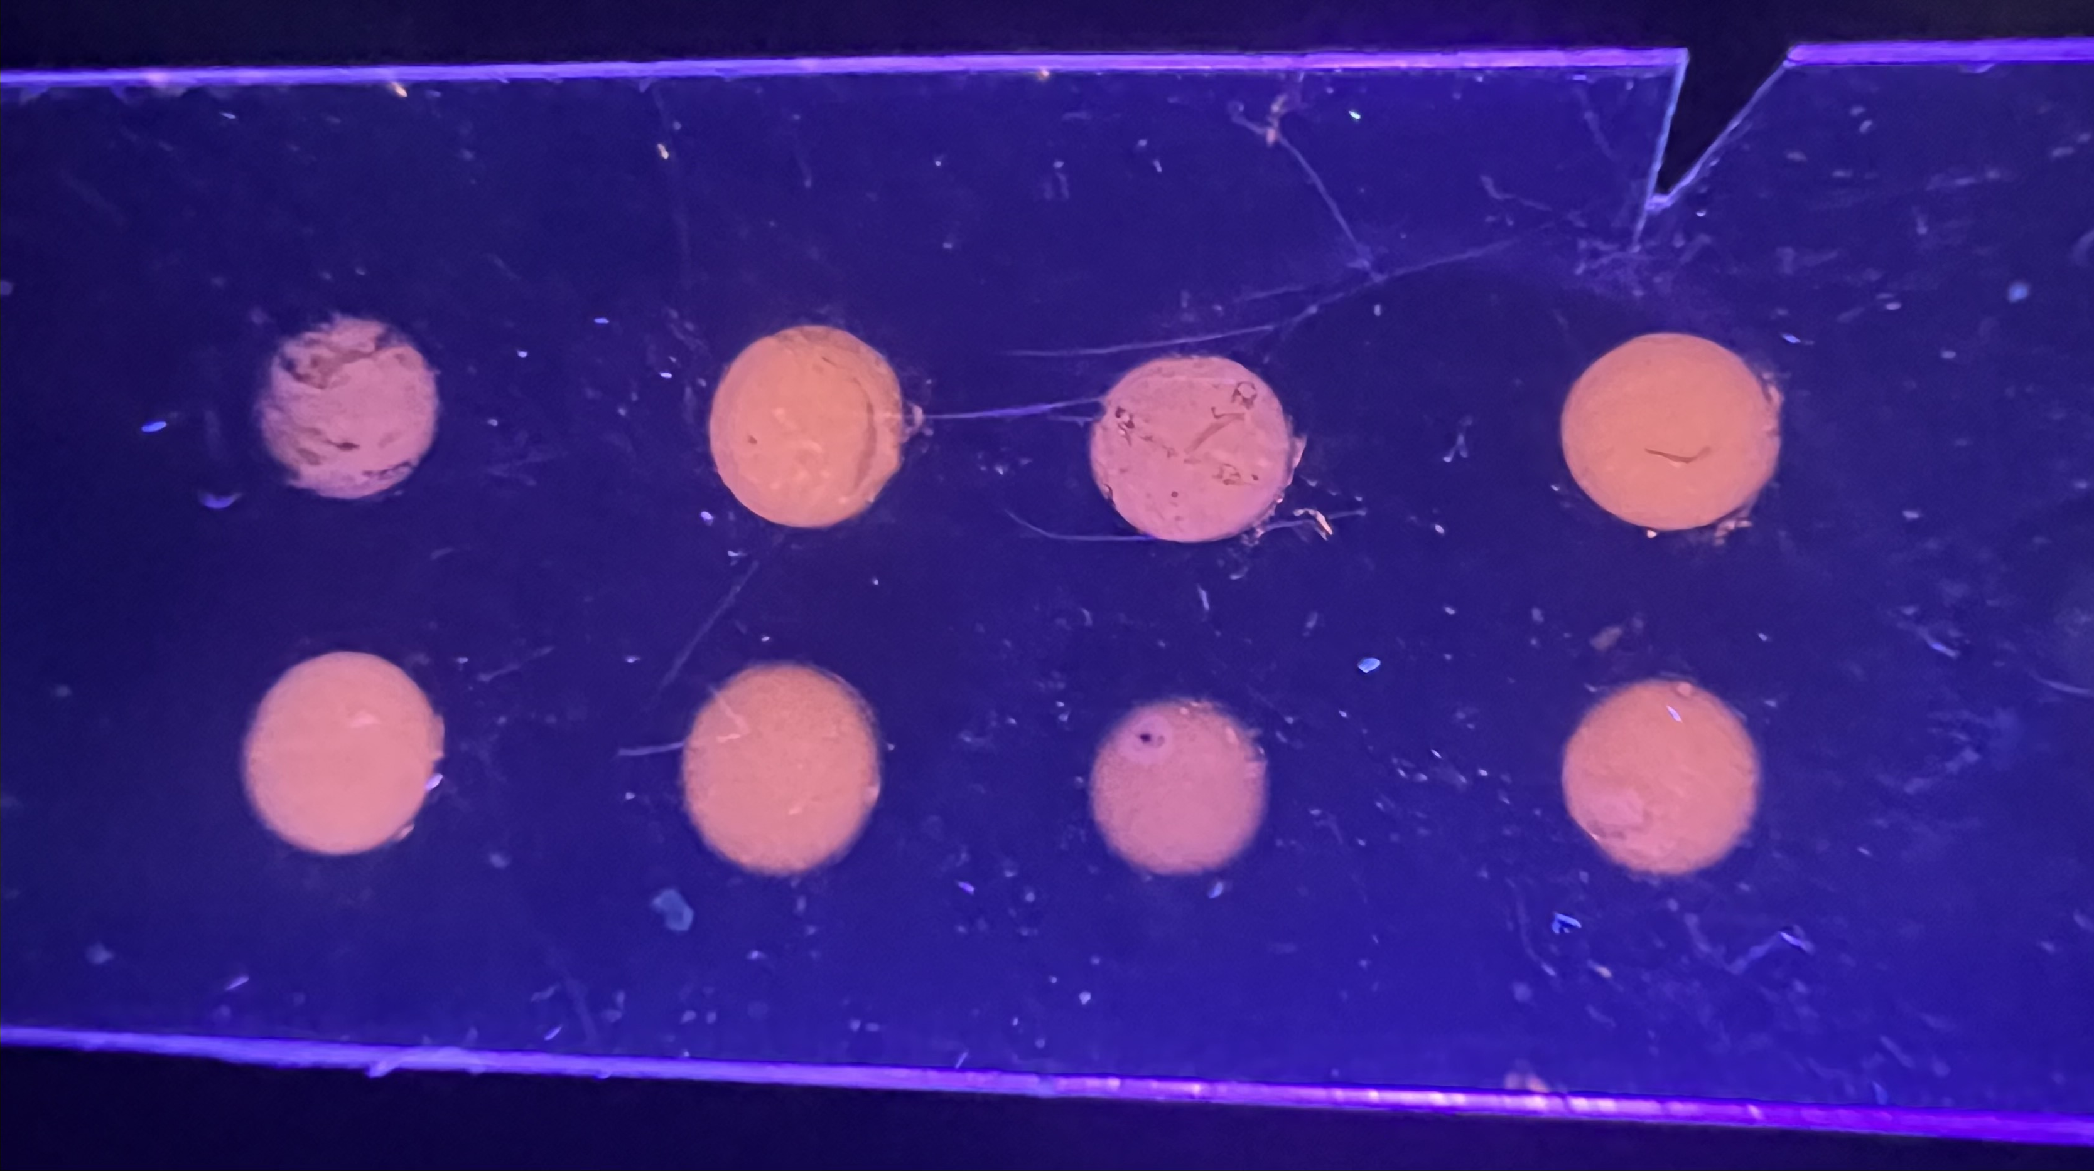
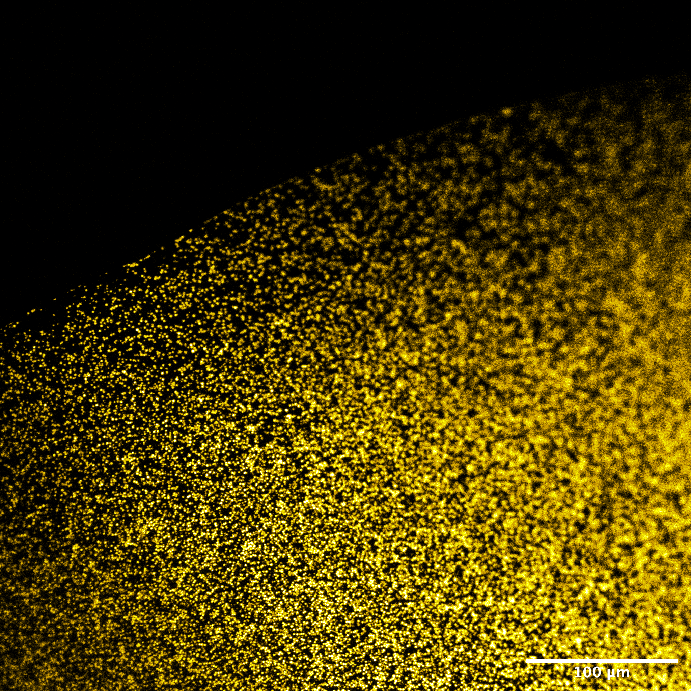
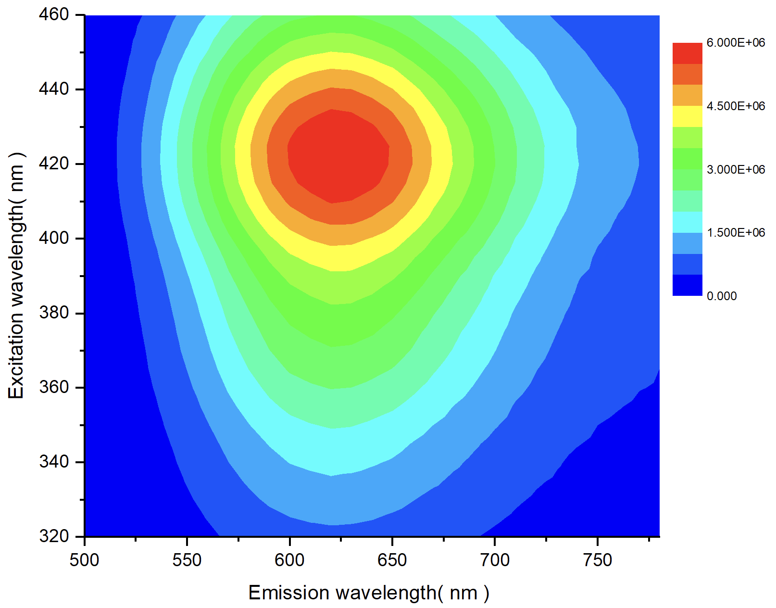
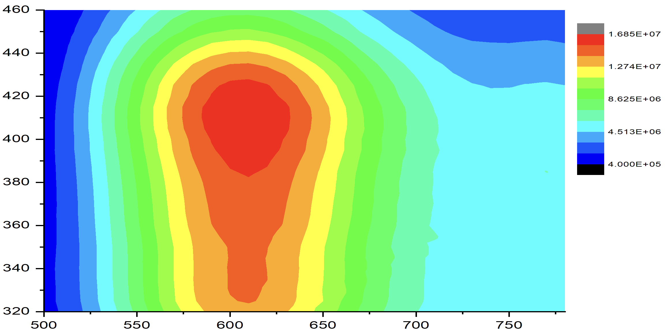
Solid sensor prototype
Confocal microscope
100 µm
Silanized ITO-PET
Photoluminescence MAP
Excitation wavelength (nm)
Excitation wavelength (nm)
Liquid
Solid
10
Emission wavelength (nm)
Emission wavelength (nm)

Slide 12
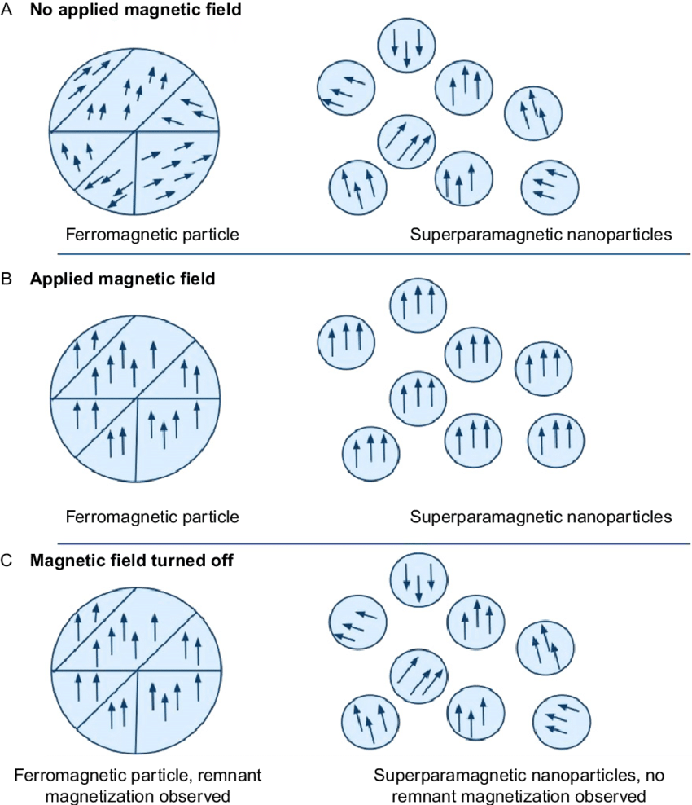
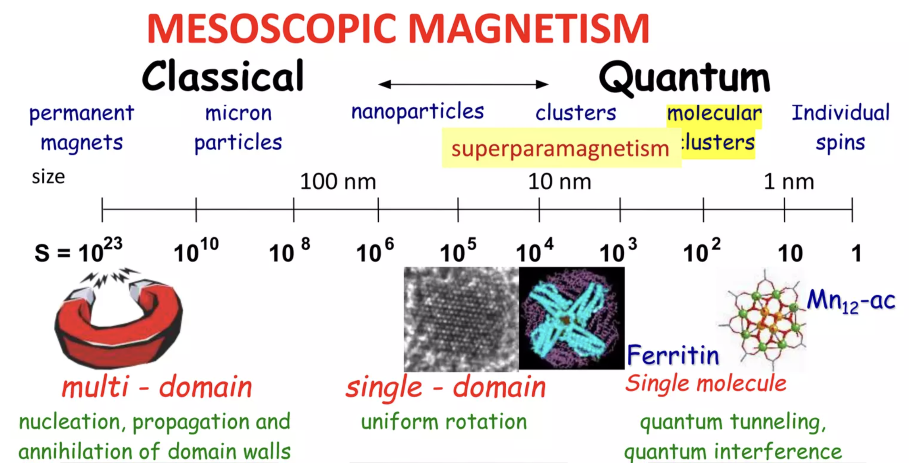
Iron Oxide Nanoparticels (IONPs)
Chapter 11. Magnetic Nanoparticles for Application in Biomedical Sensing
11

Slide 13
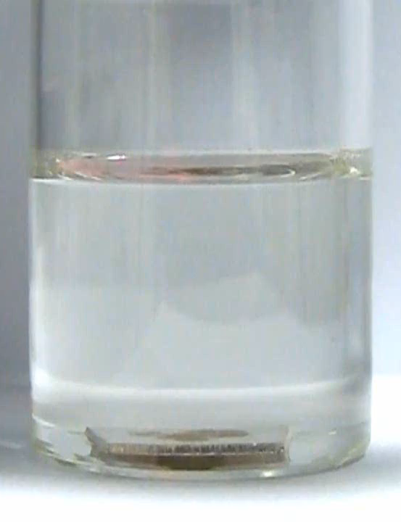

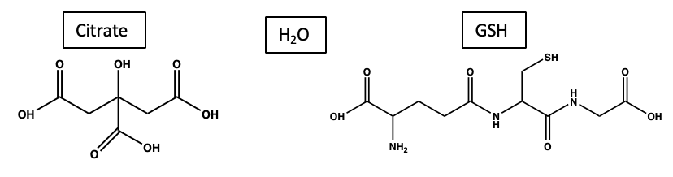
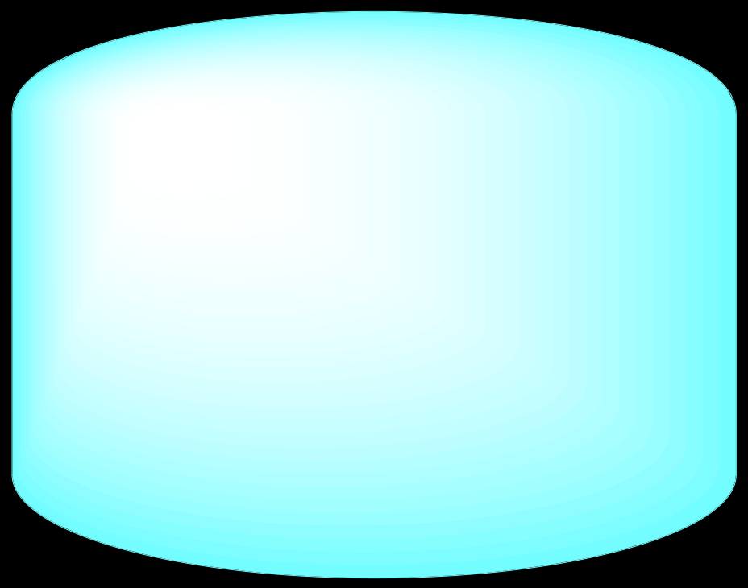
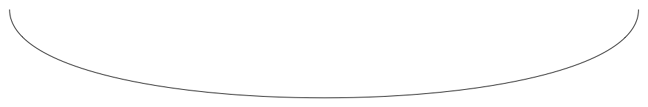
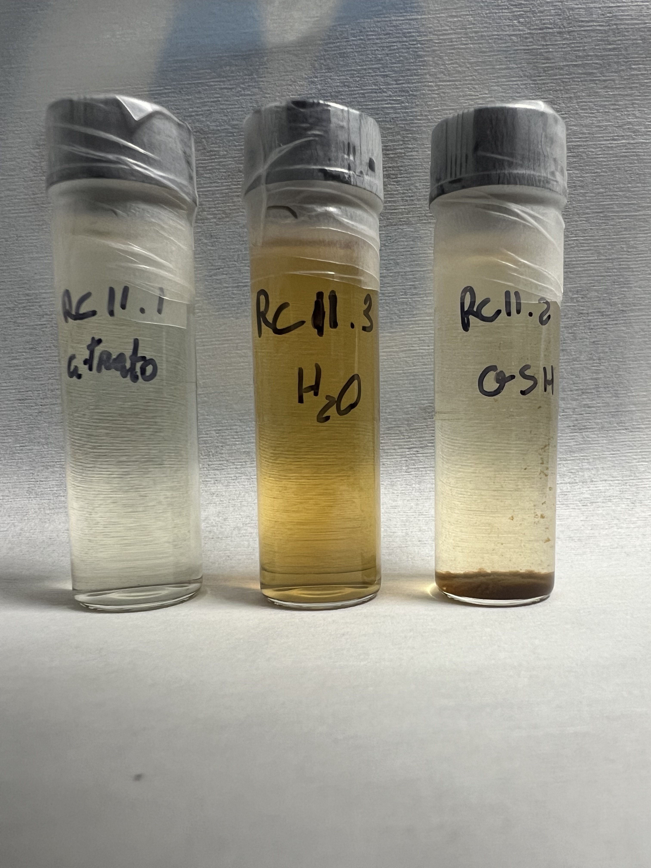
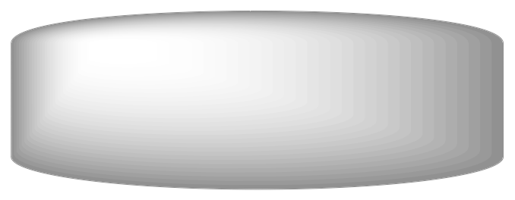
Iron Oxide NPs synthesis
Laser beam
Citrate
H₂O
GSH
NPs
Iron target
R. Chiechio et Al., Journal of Physics and Chemistry of Solids - Submitted
12

Slide 14
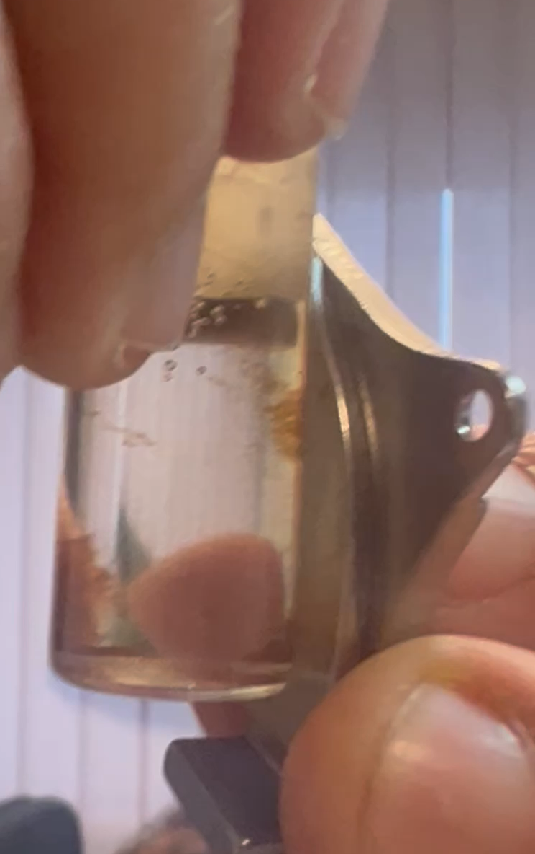
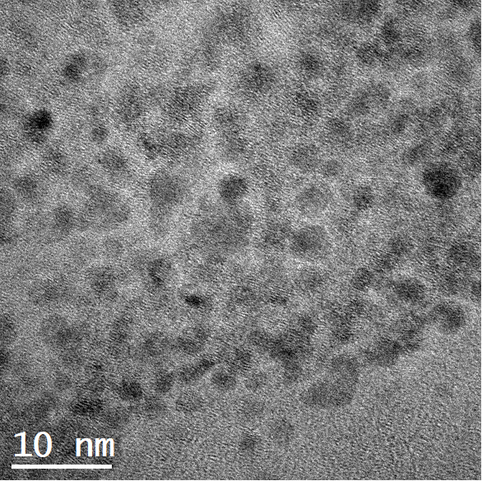
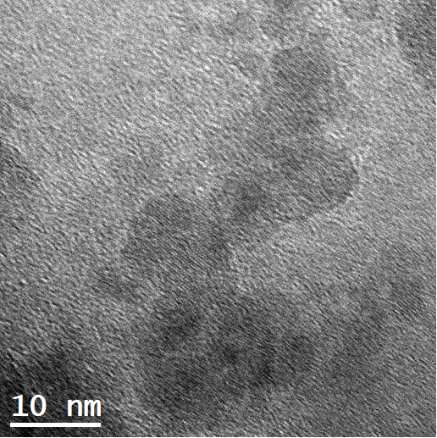
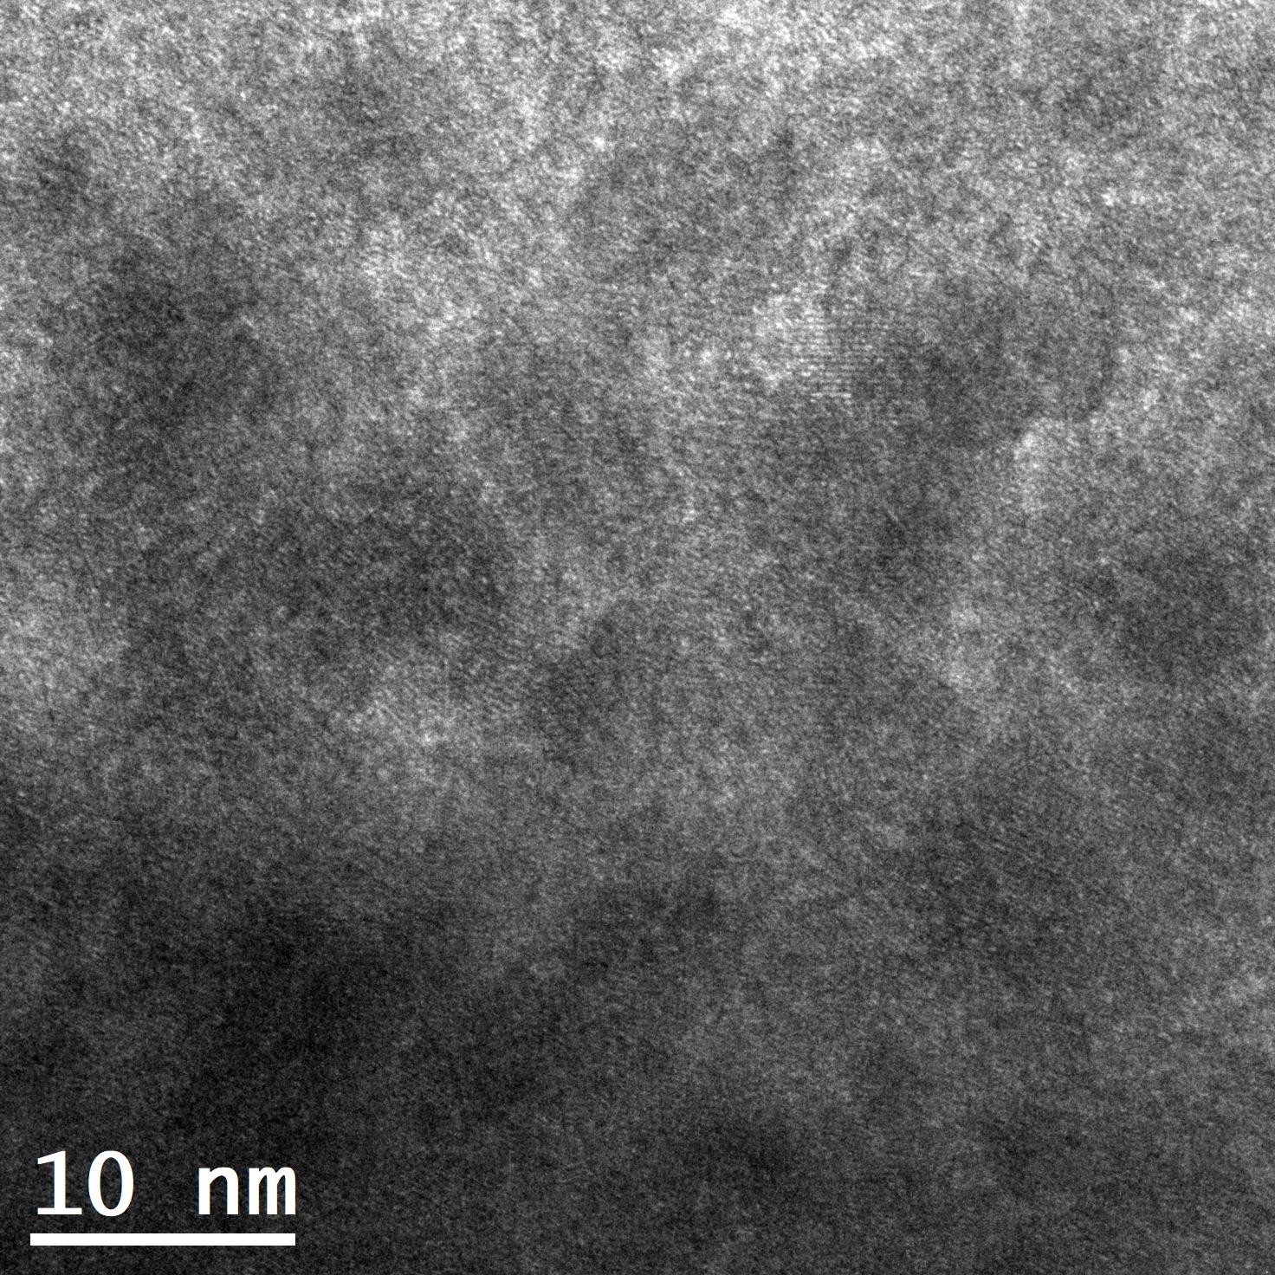
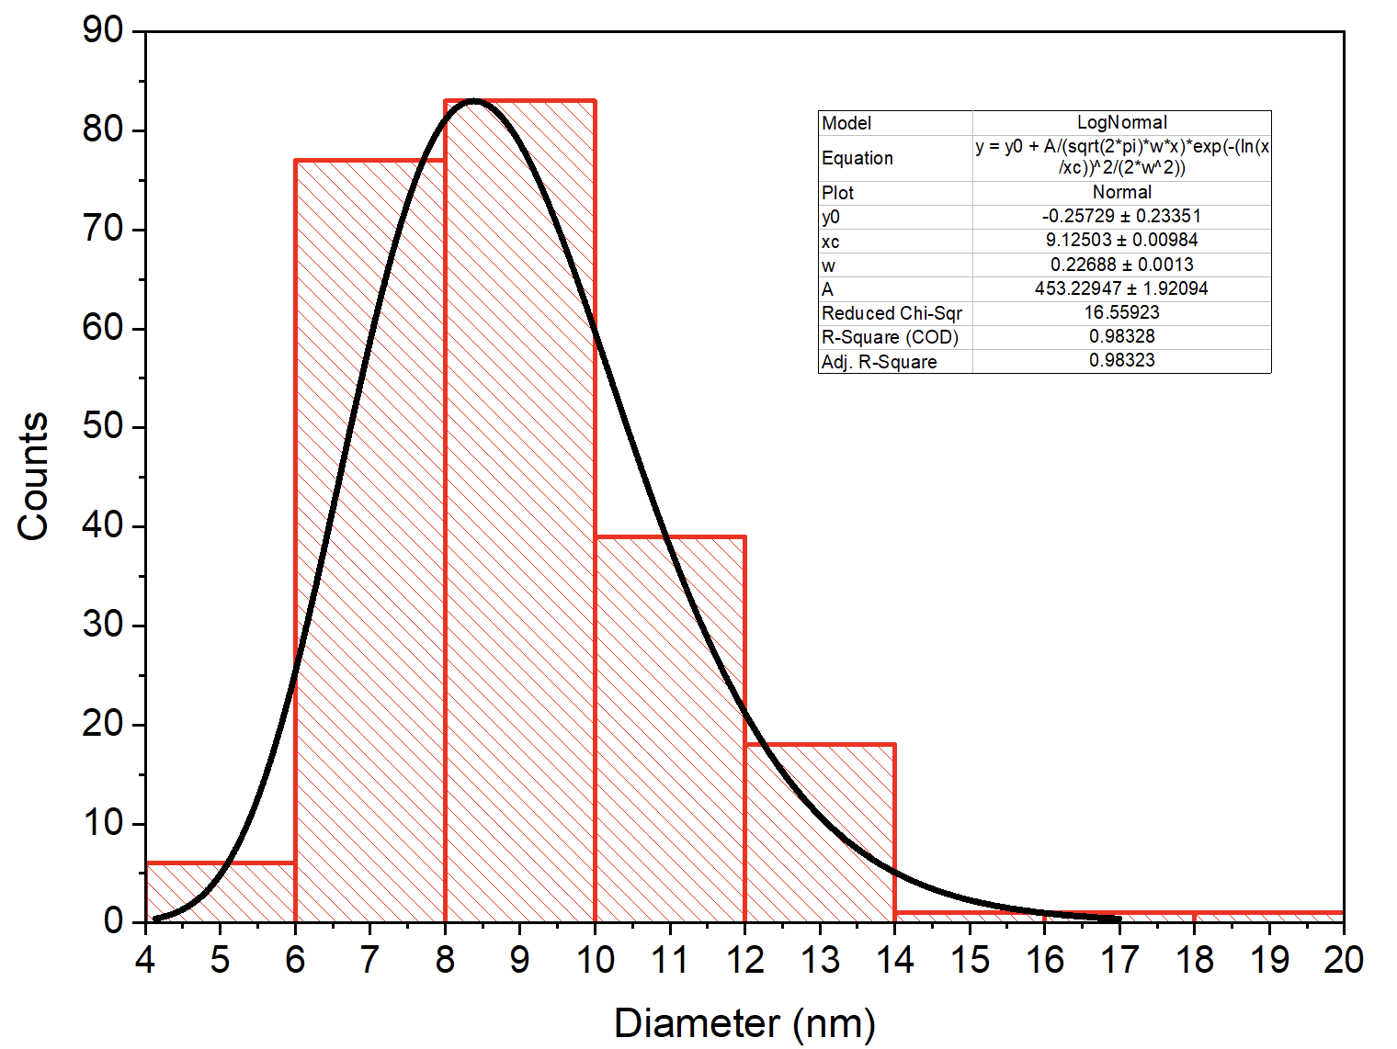
IONPs: Morphological characterization
TEM
H2O
GSH
Citrato
d≃9 nm
SEM
200 nm
200 nm
200 nm
R. Chiechio et Al., Journal of Physics and Chemistry of Solids - Submitted
13

Slide 15
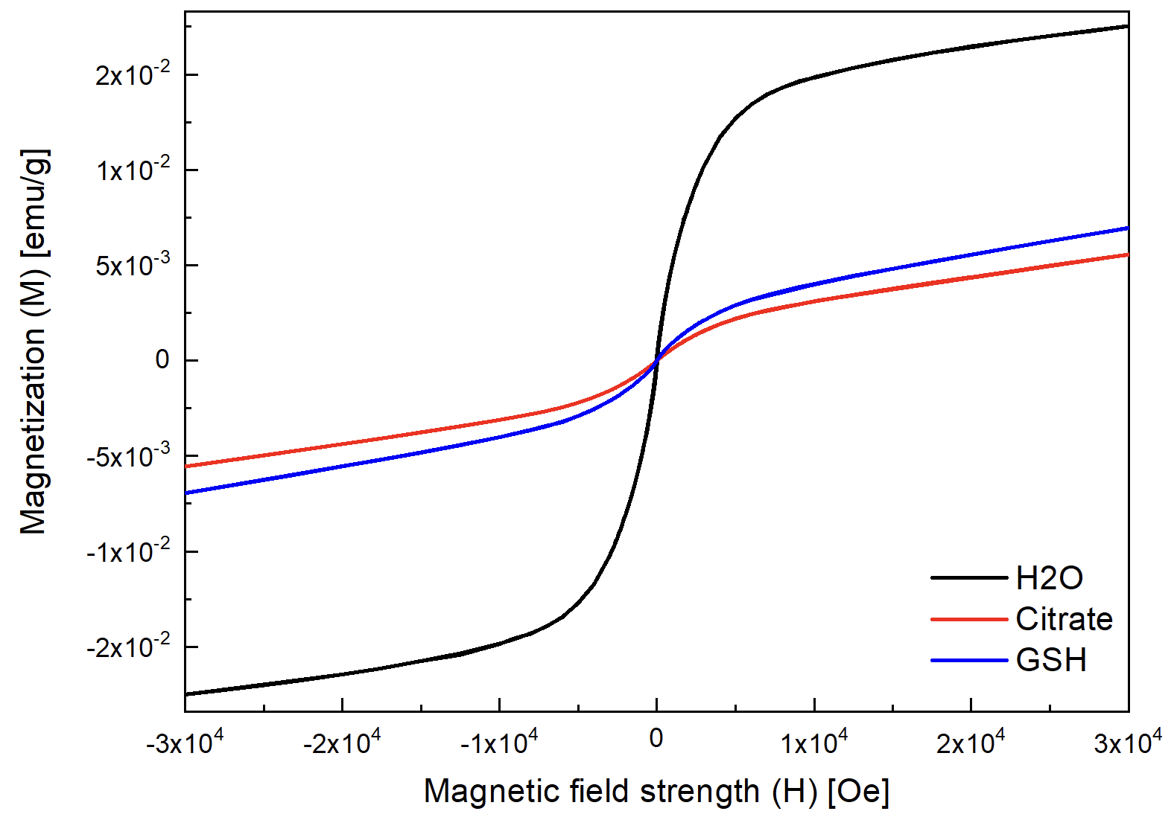
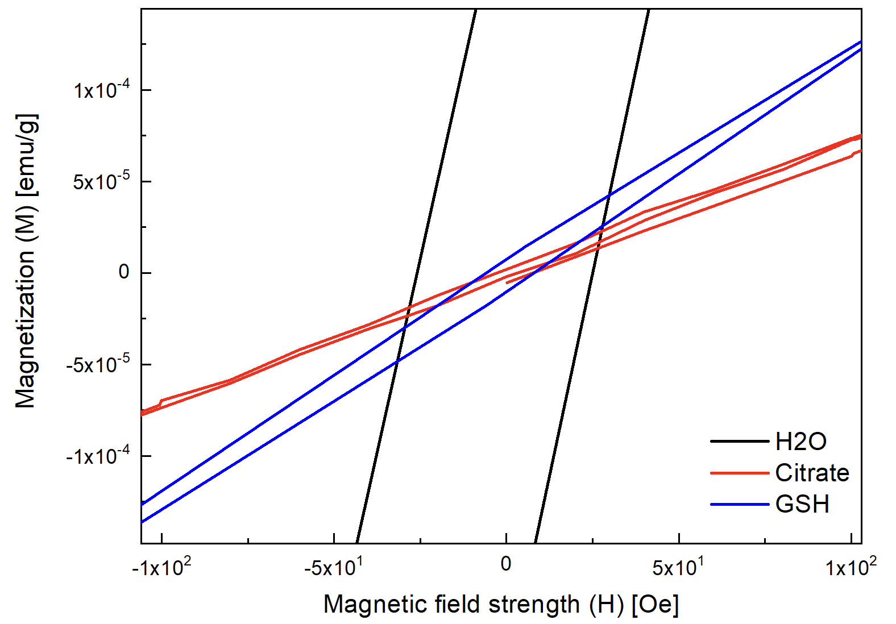
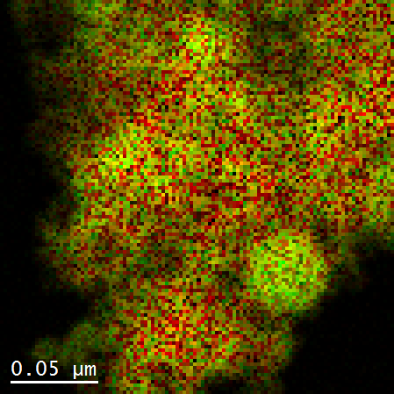
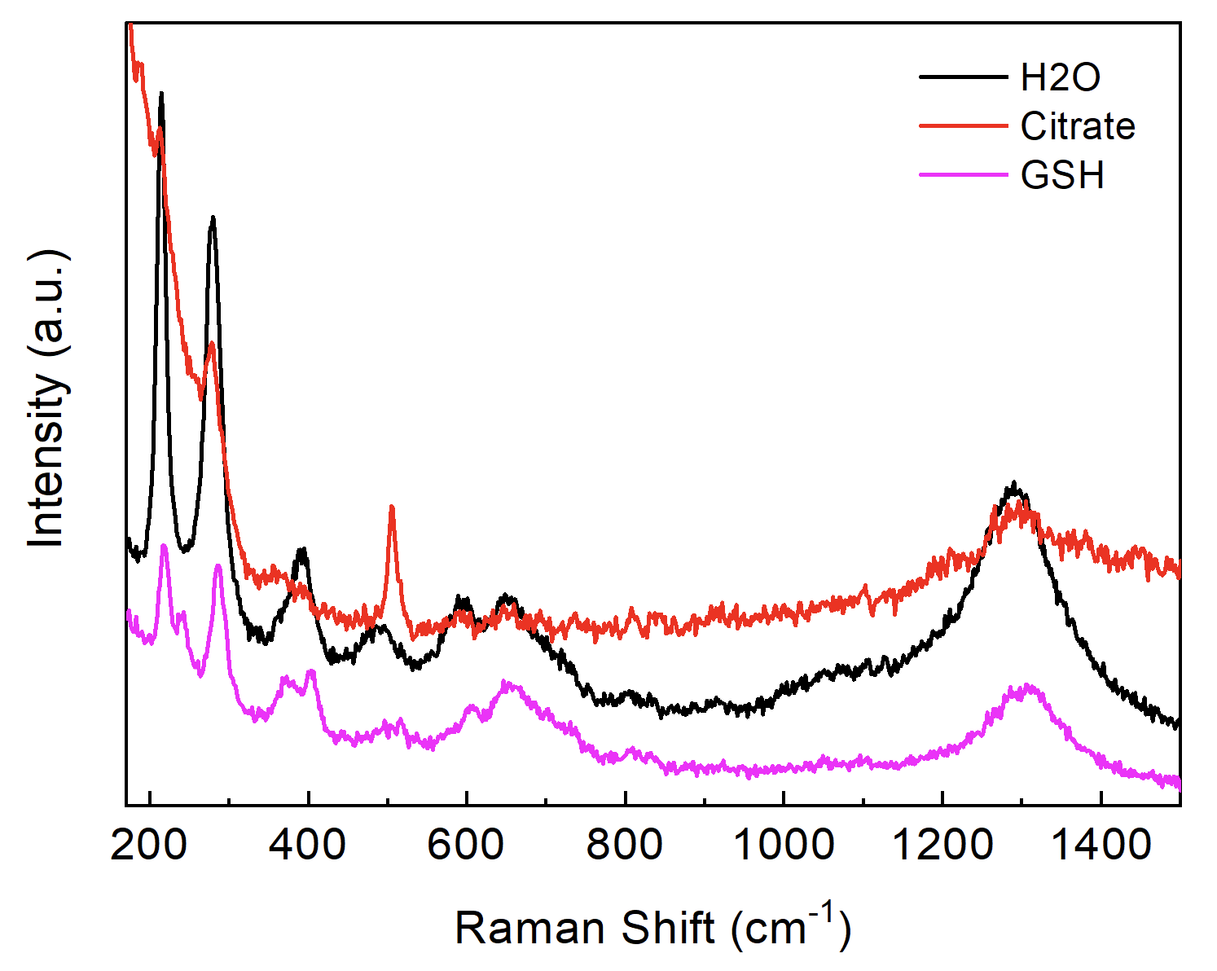
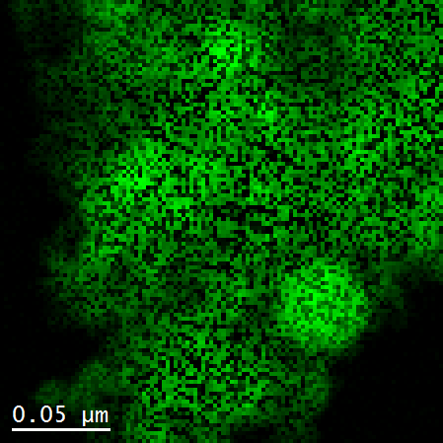
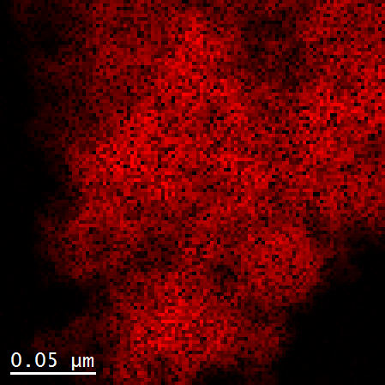
IONPs: Compositional characterization
STEM-EELS
H2O
Fe - O
HR-TEM Diffraction
SQUID
H₂O
Citrate
GSH
Fe₂O₃
5 nm
5 nm
Fe₃O₄
RAMAN
Fe
O
Fe₃O₄
Fe₂O₃
Fe₃O₄
R. Chiechio et Al., Journal of Physics and Chemistry of Solids - Submitted
14

Slide 16

Solid Sensor: IONPs anchoring on substrate
Cotton
Nylon
Fe₃O₄ NPs
Nylon
or cotton
200 µm
100 µm
H₂O
Citrate
600 nm
600 nm
15

Slide 17

Conclusions
Synthesis and characterization of quantum nanostructures
Optical, chemical and magnetic biosensing for biomedical and environmental applications
Silanized ITO-PET
16

Slide 18



Thanks

Slide 19
Thank you for your attention!

Slide 20


Nanodiamonds: Quantum Biosensors
Perspectives
Khalid, A. et al. Lifetime Reduction and Enhanced Emission of Single Photon Color Centers in Nanodiamond via Surrounding Refractive Index Modification. Sci Rep 5, 11179 (2015).
Su, J., et Al (2025), Fluorescent Nanodiamonds for Quantum Sensing in Biology. WIREs Nanomed Nanobiotechnol, 17: e70012.
17

Slide 21
ssDNA-target
ssDNA-probe
dsDNA
S
S

Slide 22






PL
Target at different concentrations
Hill Model:
LOD: 32 pM
$$Y=\frac{Vmax}{1{+(x/Kd)}^{n}}$$
(Li, W et Al., Nanoscale Adv. – 2020)
R. Chiechio et Al., Applied Surface Science Advances - 2025
Sensitivity: 14498 cps/nM
Kd=2.96 nM
n=0.466
5

Slide 23

Higher probe concentration
Photoluminescence
LOD: 25 aM
6
R. Chiechio et Al., Applied Surface Science Advances - 2025
$$Y=\frac{Vmax}{1{+(x/Kd)}^{n}}$$

Slide 24

IONPs: Compositional characterization
STEM-EELS
H2O
Fe - O
SQUID
HR-TEM Diffraction
SQUID
300 K
H₂O
Citrate
GSH
5 K
Fe₂O₃
5 nm
5 nm
Fe₃O₄
RAMAN
Fe
O
Fe₃O₄
Fe₂O₃
Fe₃O₄
R. Chiechio et Al., Journal of Physics and Chemistry of Solids - Submitted
14

Slide 25
H₂O
GSH
Citrate
Laser beam
NPs
Iron target

Slide 26


Fluxgate magnetometer
$$H_{0}$$
I
$$B_{exc}$$
U(m)
U(m)
Excitation coil
0
m
m
Pick-up
coil
$$V_{out}$$
Residence Times Difference
$$RTD=T^{+}−T^{−}$$
Salvatore Graziani
Salvo Baglio
Claudia Ferro
Piero D’Arrigo
Ferromagnetic core
Notes:
This sensor is an innovative device to detect quasi-static perturbations of the external magnetic field.
The sensor is composed of two sections: 1) a primary coil 900 turns, and 2) a secondary coil 900 turns.
The coils are wound around a flexible ferromagnetic core (having a diameter of about 100 μm.
A periodic voltage is applied to the excitation coil (Vin); hence, a periodic magnetic field He, parallel to the long axis of the core, is generated. Hx is the quasi-static “target” magnetic field, which represents (in this case) the iron compounds in the brain. The magnetometer works by exploiting the information measured through the pick-up coil (Vout signal).
The produced magnetic field is symmetric, while the external magnetic field create an asymmetry in the potential and then in the pick-up coil tension.
The voltage response is a “spike train,” the first derivative of the core magnetization. The distance between two spikes is not equal passing to a polarization to the other, since the target external field create an asymmetry. So the sensor measure the difference between this two time of magnetization (positive and negative) to quantify the external field.
By changing the magnetic property of the material, as a smaller coercive field and a higher permeability, it is possible to obtain a sensor more rapid e more sensible. And we wanted also to create a wereable sensor by increasing the core flexibility without breaking the magnetic domain. So we want to improve the functional and structural properties.
RTD = T+ − T −.
In the absence of an external magnetic field, the RTD = 0
B= Magnetic Field Density

Slide 27


Fluxgate magnetometer
$$H_{0}$$
I
$$B_{exc}$$
Excitation coil
0
Pick-up
coil
Fe₃O₄ NPs
$$V_{out}$$
Plastic
or fabric
Salvatore Graziani
Salvo Baglio
Claudia Ferro
Piero D’Arrigo
Ferromagnetic core
Flexible ferromagnetic core
Notes:
This sensor is an innovative device to detect quasi-static perturbations of the external magnetic field.
The sensor is composed of two sections: 1) a primary coil 900 turns, and 2) a secondary coil 900 turns.
The coils are wound around a flexible ferromagnetic core (having a diameter of about 100 μm.
A periodic voltage is applied to the excitation coil (Vin); hence, a periodic magnetic field He, parallel to the long axis of the core, is generated. Hx is the quasi-static “target” magnetic field, which represents (in this case) the iron compounds in the brain. The magnetometer works by exploiting the information measured through the pick-up coil (Vout signal).
The produced magnetic field is symmetric, while the external magnetic field create an asymmetry in the potential and then in the pick-up coil tension.
The voltage response is a “spike train,” the first derivative of the core magnetization. The distance between two spikes is not equal passing to a polarization to the other, since the target external field create an asymmetry. So the sensor measure the difference between this two time of magnetization (positive and negative) to quantify the external field.
By changing the magnetic property of the material, as a smaller coercive field and a higher permeability, it is possible to obtain a sensor more rapid e more sensible. And we wanted also to create a wereable sensor by increasing the core flexibility without breaking the magnetic domain. So we want to improve the functional and structural properties.
RTD = T+ − T −.
In the absence of an external magnetic field, the RTD = 0
B= Magnetic Field Density

Slide 28



Fluxgate Magnetometer Applications
Fettin detection inside brain for neurodegenerative deseases
Volcanic ash fallout estimation
C. Trigona et Al. in IEEE Transactions on Instrumentation and Measurement, vol. 67, no. 4, pp. 971-980, April 2018
B. Ando1 et Al. 2008 - IEEE International Instrumentation and Measurement Technology Conference
9

Slide 29



Iron Oxide Nanoparticles
Fe₃O₄ NPs
Nylon
or cotton
$$H_{0}$$
Laser beam
$$B_{exc}$$
Citrate
H₂O
GSH
Excitation
Coil (I_{e})
Pick-up
Coil (V_{out})
NPs
Iron target

Slide 30













200 nm
Compositional characterization
STEM-EELS
a)
H2O
Fe - O
b)
GSH
Fe - O
c)
Citrate
Fe - O
Fe
O
Fe
O
Fe
O
C - N
C
N
C

Slide 31


Compositional characterization
Fe₂O₃
Fe₃O₄
RAMAN
HR-TEM Diffraction
H₂O
GSH
Citrate
Raman Shift cm⁻¹
5 nm
5 nm
XRD
(2-20)
(004)
{-101-5}
(20-2)
(02-2)
(1-1-3)
{-1-12-2}
(2-20)
(-11-3)
[111] Fe₃O₄
[110] Fe₃O₄
Fe₂O₃

Slide 32



Magnetical characterization
SQID measurements M(H)
300 K
5 K
500 Oe
SQID measurements M(T)
Notes:
Magnetical characterization (SQID)

Slide 33

Spettroscopia dei Difetti Emettitori di Singoli Fotoni nel Diamante
Questo studio esplora le proprietà spettroscopiche dei centri di colore nel diamante che fungono da emettitori di singoli fotoni (SPE). Questi difetti atomici mostrano caratteristiche di antibunching, e quindi emissione di fotoni singoli.
Amanuel Michael Berhane, Spectroscopy of single photon emitting defects in Gallium Nitride and Diamond, 2018
(a) Struttura atomica del centro NV nella cella unitaria del diamante (b) Spettro di un centro NV che mostra il picco di fluorescenza del NV- a 637 nm.

Slide 34

Diamante con centri NV: robustezza e lettura di spin
Stabilità ottima
Proprietà di spin
Versatilità di formato
Fotoluminescenza intensa e stabile a temperatura ambiente, anche in condizioni ambientali variabili
Accesso ottico allo stato di spin, utile per magnetometria e termometria quantistica
Disponibile come punte AFM, film sottili o nanoparticelle per diverse geometrie di sensing
Caratteristiche:
Limitazione principale: Richiede strumentazione e processi di fabbricazione altamente specializzati
Applicazione ottimale: Misurazioni locali ad alta sensibilità (campi magnetici, temperatura) con risoluzione nanometrica.
I centri NV (Nitrogen-Vacancy) nel diamante combinano proprietà ottiche e di spin che li rendono ideali per applicazioni di sensing quantistico.
Qureshi, S.A. et Al., «Recent Development of Fluorescent Nanodiamonds for Optical Biosensing and Disease Diagnosis». Biosensors 2022, 12, 1181

Slide 35
Khalid, A., Chung, K., Rajasekharan, R. et al. Lifetime Reduction and Enhanced Emission of Single Photon Color Centers in Nanodiamond via Surrounding Refractive Index Modification. Sci Rep 5, 11179 (2015). https://doi.org/10.1038/srep11179

Slide 36
Su, J., Kong, Z., Zeng, L., Kong, F., Xia, K., Shi, F. and Du, J. (2025), Fluorescent Nanodiamonds for Quantum Sensing in Biology. WIREs Nanomed Nanobiotechnol, 17: e70012.

Slide 37
Qureshi, S.A. et Al., «Recent Development of Fluorescent Nanodiamonds for Optical Biosensing and Disease Diagnosis». Biosensors 2022, 12, 1181
13

Slide 38
Nanodiamonds: Quantum Biosensors
Perspectives
Qureshi, S.A. et Al., «Recent Development of Fluorescent Nanodiamonds for Optical Biosensing and Disease Diagnosis». Biosensors 2022, 12, 1181
Khalid, A. et al. Lifetime Reduction and Enhanced Emission of Single Photon Color Centers in Nanodiamond via Surrounding Refractive Index Modification. Sci Rep 5, 11179 (2015).
17

Slide 39

Takuya F. Segawa, Ryuji Igarashi,
Nanoscale quantum sensing with Nitrogen-Vacancy centers in nanodiamonds – A magnetic resonance perspective,
Progress in Nuclear Magnetic Resonance Spectroscopy,
Volumes 134–135,
2023,
Pages 20-38,
ISSN 0079-6565,

